Slide 1
Supplemental Figure 1: PFAS screening workflow
Chemical procurement
Single-concentration (sc) screening
MEA NFA
131 sc
MEA NFA
136 sc apoptosis & proliferation assays
PFAS re-procurement
Microelectrode array (MEA) network formation assay (NFA)
132 sc NOG
Analytical QC
5 PFAS bypassed sc due to low chemical stock
High-content imaging (HCI) technology
Original PFAS procurement and other DNT screens
Inactive
Active
Inactive
Active
94 inactives:
Stop for 56 not tested in mc; 38 tested in original procurement mc screen
83 inactives:
Stop for 79 not tested in mc; 4 screened in mc
Multi-concentration (mc) screening
53 sc HCI actives and 4 sc HCI inactives screened in mc HCI
74 mc MEA NFA
5 mc MEA NFA
37 sc MEA NFA actives actives screened in mc MEA NFA
Datasets for interpretation
56 sc MEA NFA only (inactive)
79 sc HCI only (inactive)
104 unique PFAS in mc MEA NFA
57 unique PFAS in mc HCI
160 unique PFAS

Slide 2
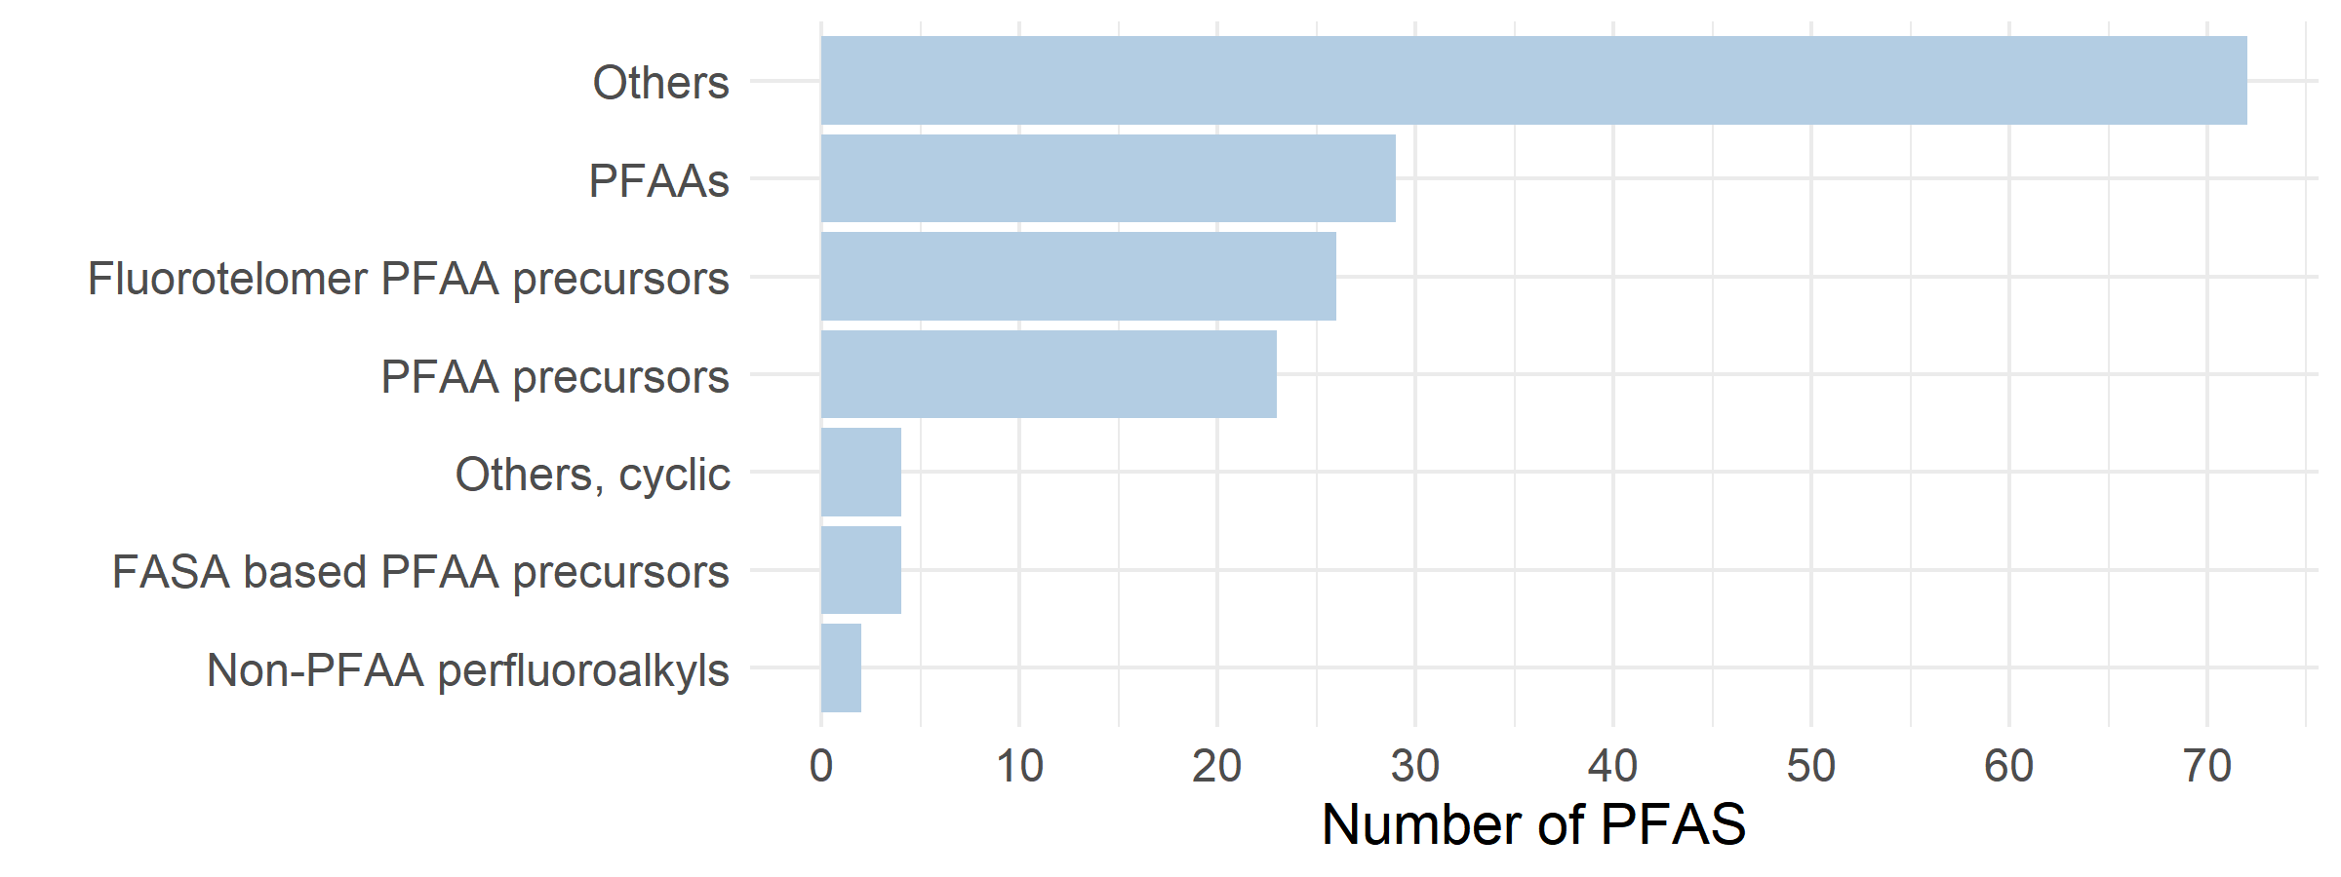
Supplemental Figure 2. OECD structural categories of total unique PFAS in DNT NAM dataset

Slide 3
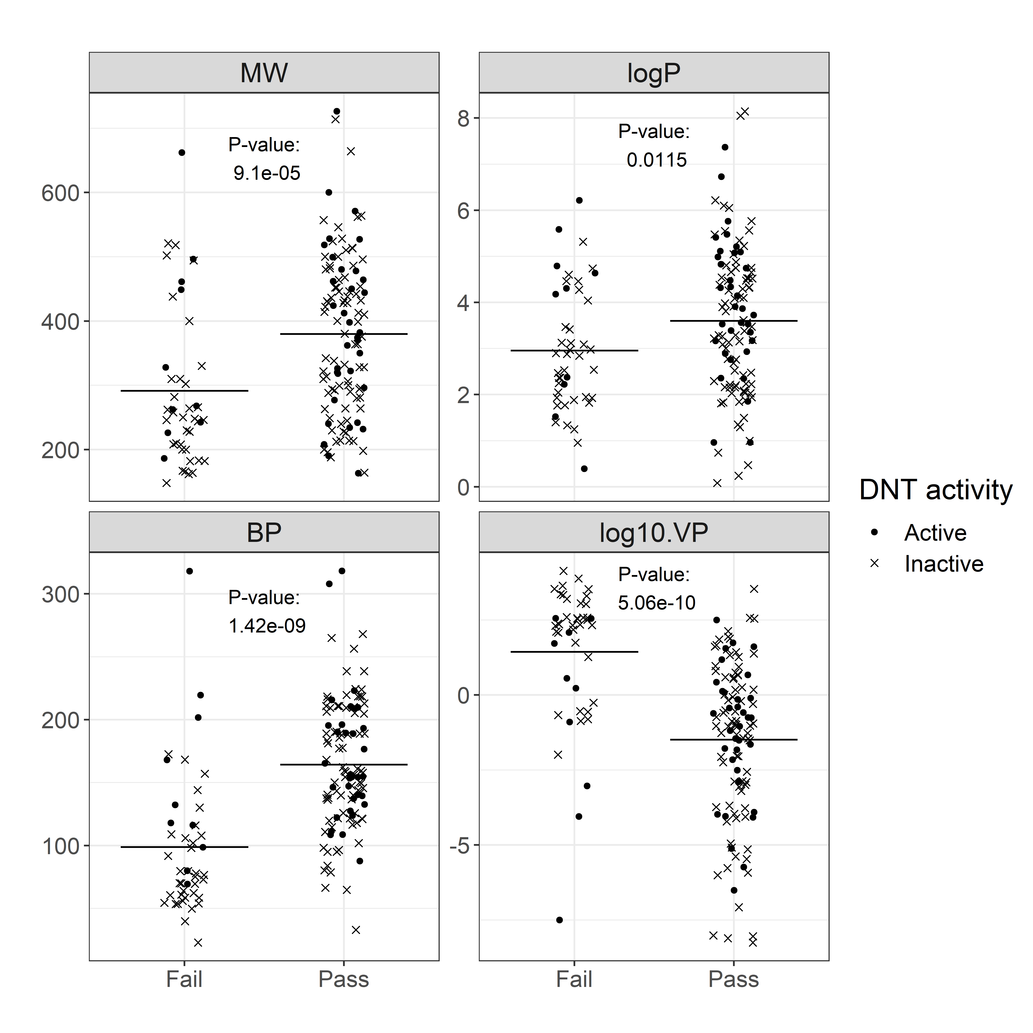
Supplemental Figure 3. QC results and Physicochemical properties

Slide 4
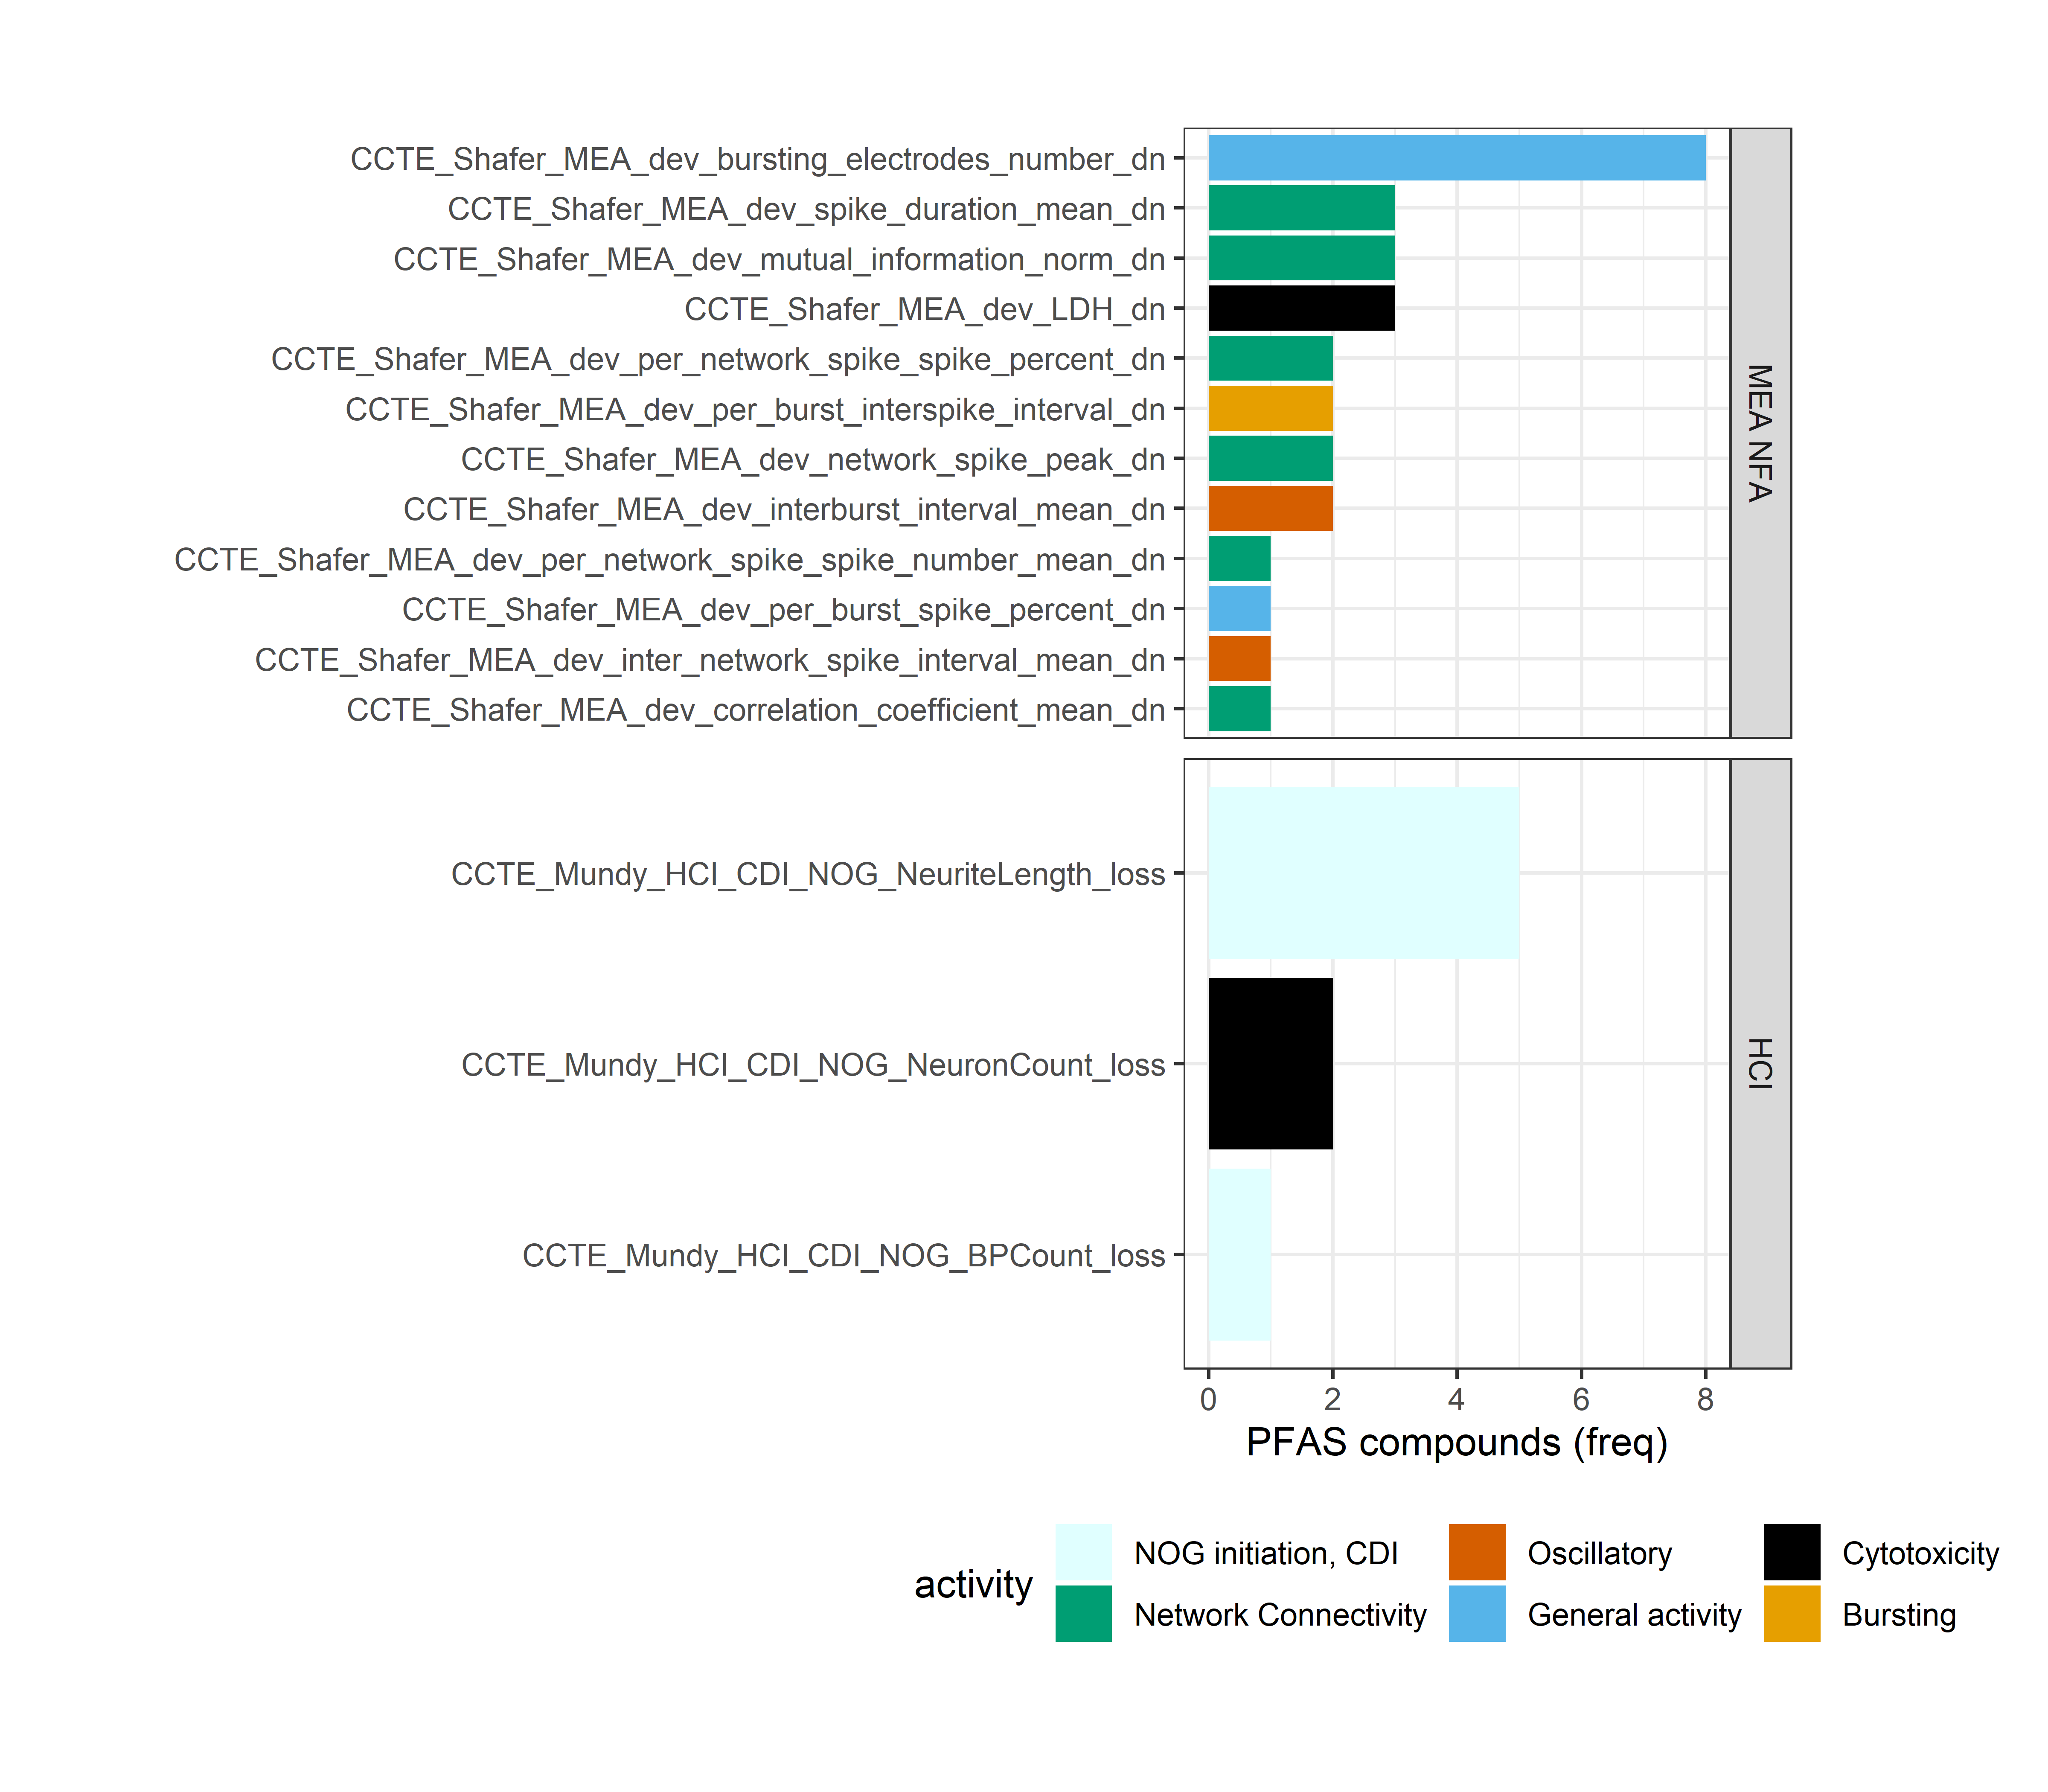
Supplemental Figure 4A. Assay endpoint sensitivity to PFAS
i) Endpoint that determines the minimum potency (AC₅₀) by chemical
ii) Mean AC₅₀ by endpoint (excluding QC fail PFAS)
Endpoint | Mean AC₅₀ (log10-uM) | StDev AC₅₀ (log10-uM)
CCTE_Shafer_MEA_dev_bursting_electrodes_number_dn | 0.315 | 0.529
CCTE_Shafer_MEA_dev_network_spike_number_dn | 0.392 | 0.321
CCTE_Shafer_MEA_dev_per_burst_interspike_interval_dn | 0.436 | 0.863
CCTE_Shafer_MEA_dev_burst_rate_dn | 0.456 | 0.303
CCTE_Shafer_MEA_dev_mutual_information_norm_dn | 0.474 | 0.383
CCTE_Shafer_MEA_dev_active_electrodes_number_dn | 0.518 | 0.474
CCTE_Shafer_MEA_dev_per_network_spike_spike_percent_dn | 0.548 | 0.359
CCTE_Shafer_MEA_dev_firing_rate_mean_dn | 0.553 | 0.196
CCTE_Shafer_MEA_dev_network_spike_peak_dn | 0.599 | 0.571
CCTE_Shafer_MEA_dev_network_spike_duration_std_dn | 0.699 | 0.298
CCTE_Shafer_MEA_dev_per_burst_spike_percent_dn | 0.758 | 0.298
CCTE_Shafer_MEA_dev_per_network_spike_spike_number_mean_dn | 0.772 | 0.420
CCTE_Shafer_MEA_dev_burst_duration_mean_dn | 0.783 | 0.368
CCTE_Shafer_MEA_dev_inter_network_spike_interval_mean_dn | 0.794 | 0.136
CCTE_Shafer_MEA_dev_correlation_coefficient_mean_dn | 0.832 | 0.404
CCTE_Shafer_MEA_dev_spike_duration_mean_dn | 0.866 | 0.370
CCTE_Mundy_HCI_CDI_NOG_BPCount_loss | 0.932 | 0.717
CCTE_Shafer_MEA_dev_interburst_interval_mean_dn | 0.952 | 0.472
CCTE_Shafer_MEA_dev_LDH_dn | 1.094 | 0.301
CCTE_Mundy_HCI_CDI_NOG_NeuronCount_loss | 1.095 | 0.530
CCTE_Mundy_HCI_CDI_NOG_NeuriteLength_loss | 1.104 | 0.384
CCTE_Shafer_MEA_dev_AB_dn | 1.194 | 0.236
CCTE_Mundy_HCI_hNP1_Casp3_7_gain | NA | NA
CCTE_Mundy_HCI_hNP1_CellTiter_loss | NA | NA
CCTE_Mundy_HCI_hNP1_Pro_ObjectCount_loss | NA | NA
CCTE_Mundy_HCI_hNP1_Pro_ResponderAvgInten_loss | NA | NA
CCTE_Mundy_HCI_CDI_NOG_NeuriteCount_loss | NA | NA

Slide 5
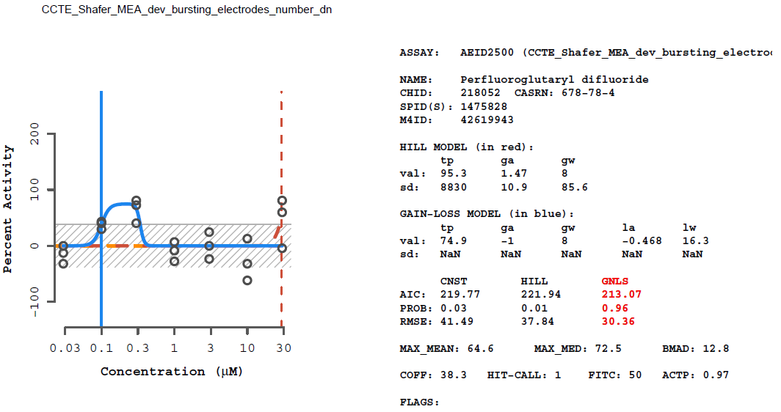
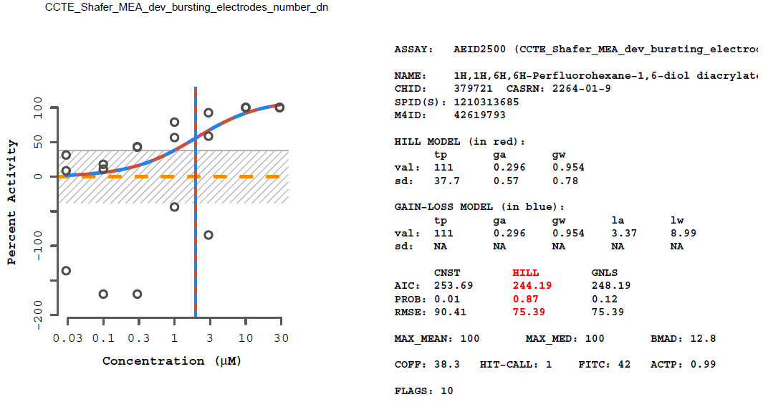
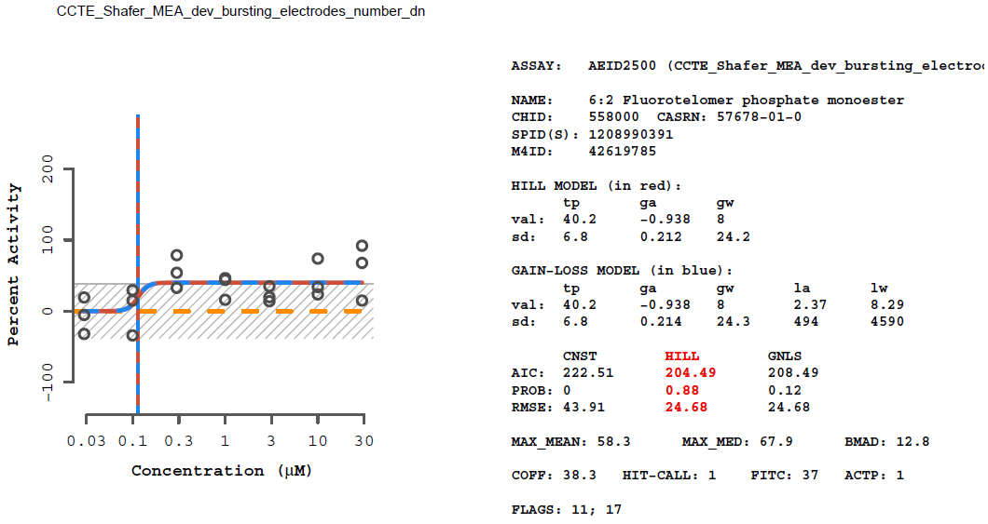
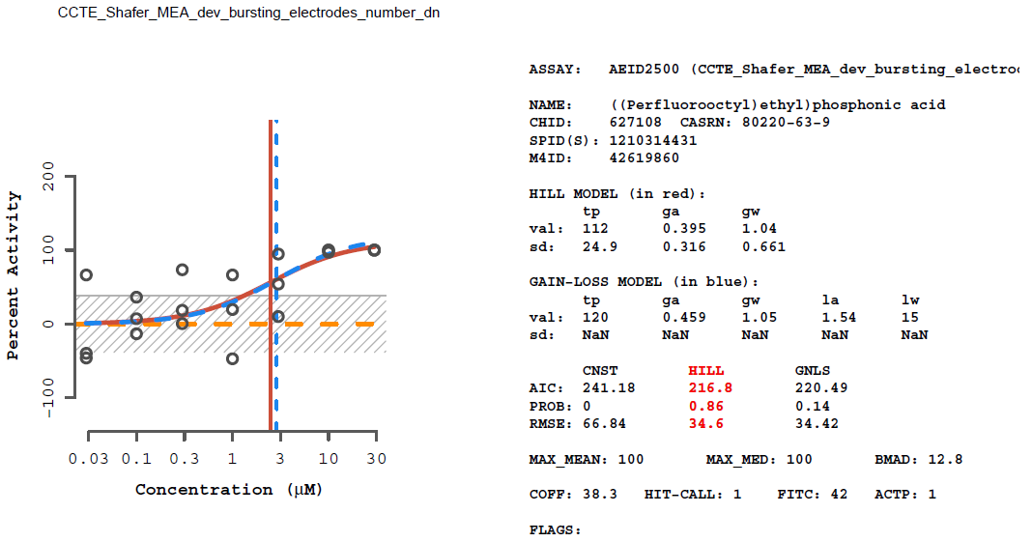
Supplemental Figure 4B. Concentration response curves for 8 PFAS for which the minimum AC₅₀ was identified by the endpoint measuring a decrease in bursting electrodes
1
2
3
4

Slide 6
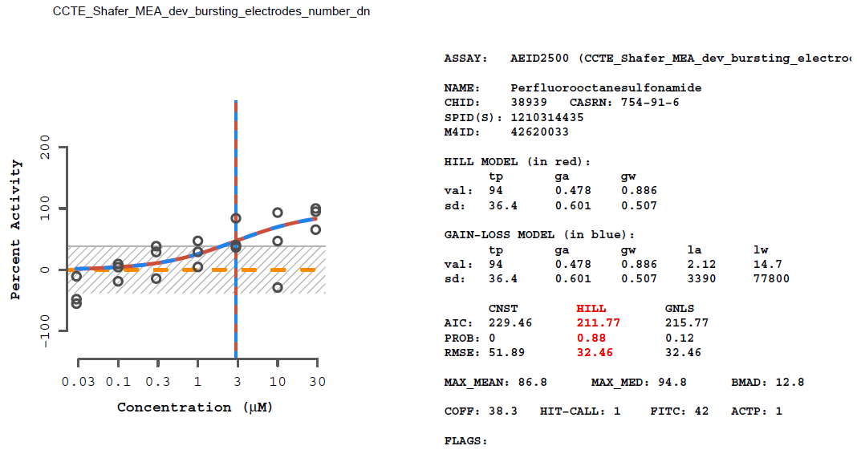
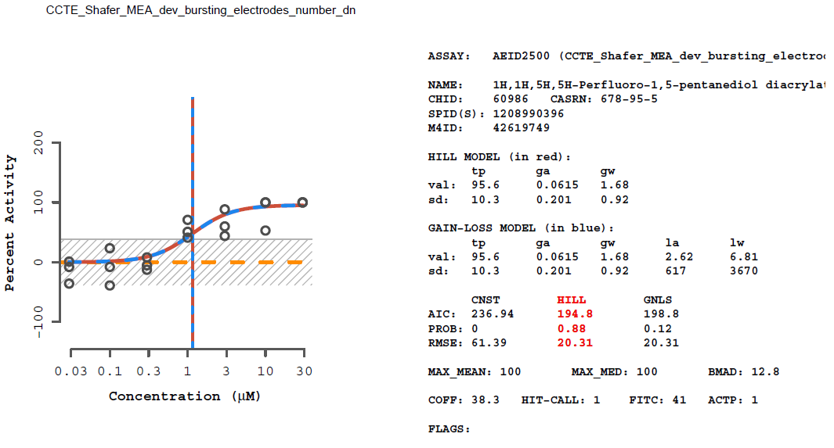
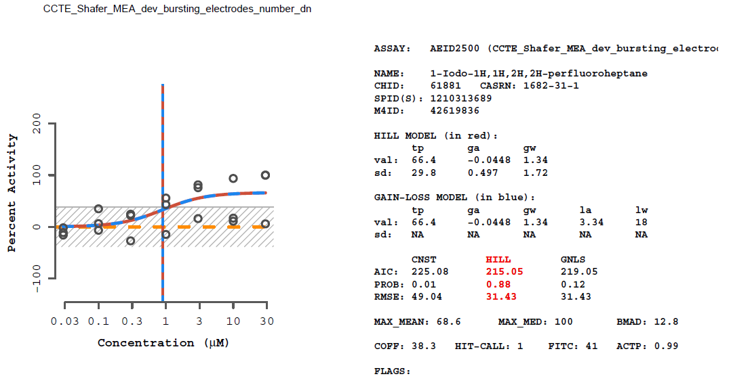
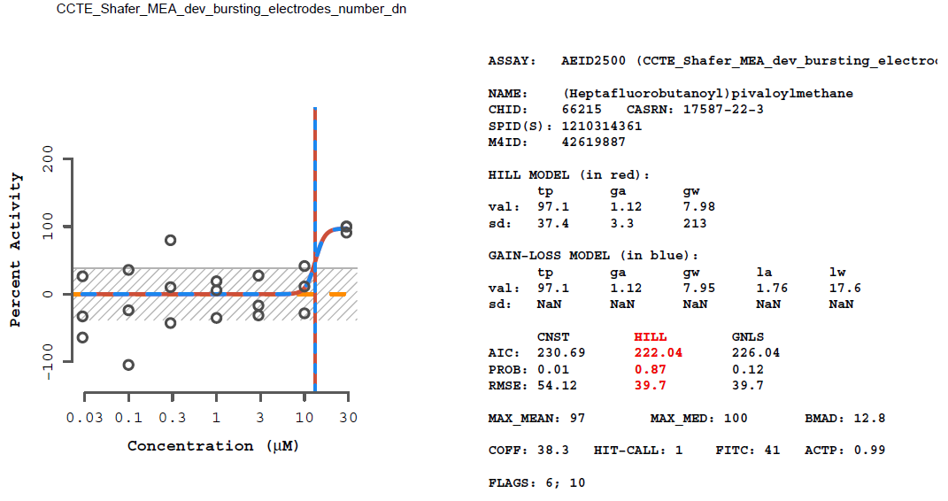
Supplemental Figure 4B. Concentration response curves for 8 PFAS for which the minimum AC₅₀ was identified by the endpoint measuring a decrease in bursting electrodes
5
6
7
8

Slide 7
Supplemental Figure 4C. Table of 8 PFAS for which the endpoint measuring decreased number of bursting electrodes (MEA NFA) identified the minimum potency
DTXSID | Hit sum | N mc endpoints tested | Mean AC50 (log10-uM) | StDev AC50 (log10-uM) | Mean AC50 (µM) | StDev AC50 (µM) | QC Pass/ Fail | Concentration response curve ID (Supplemental Figure 4B) | Evaluation of the 'MEA_dev_bursting_electrodes_number_dn’ curves (Supplemental Figure 4C) | Conclusion
DTXSID50218052 | 1 | 19 | -1.001 |  | 0.100 |  | F | 1 | This chemical demonstrates a low hit rate (1/19). There were no flags associated with the winning model. The low AC₅₀ of -1.0 log10-µM appears to be associated with the gain-loss model as the winning model. | Although the model appears to be a good fit, based on the rule that any chemical that was only active in one mc MEA NFA endpoint (excluding cytotoxicity) is equivocal, this bioactivity was classified as equivocal. This compound also failed QC therefore bioactivity should be interpreted with caution.
DTXSID80379721 | 17 | 27 | 0.505 | 0.099 | 3.202 | 1.257 | P | 2 | This chemical demonstrates a high hit rate (17/27 active endpoints) and the winning model fit was flagged for noise. | High confidence active based on the hit rate.
DTXSID90558000 | 7 | 27 | 0.375 | 0.816 | 2.374 | 6.549 | P | 3 | This chemical demonstrates a high hit rate (7/27 active endpoints) and the winning model fit was flagged for borderline activity and efficacy values less than 50%. | High confidence active based on the hit rate.
DTXSID30627108 | 17 | 27 | 0.669 | 0.138 | 4.663 | 1.375 | P | 4 | This chemical demonstrates a high hit rate (17/27 active endpoints) and the winning model fit looks good. | High confidence active based on the hit rate and curve.
DTXSID3038939 | 11 | 27 | 1.084 | 0.302 | 12.142 | 2.003 | P | 5 | This chemical demonstrates a high hit rate (11/27 active endpoints) and the winning model fit looks good. | High confidence active based on the hit rate.
DTXSID5060986 | 13 | 27 | 0.474 | 0.237 | 2.979 | 1.725 | P | 6 | This chemical demonstrates a high hit rate (13/27 active endpoints) and the winning model fit looks good. | High confidence active based on the hit rate and curve.
DTXSID9061881 | 8 | 19 | 0.981 | 0.424 | 9.565 | 2.653 | P | 7 | This chemical demonstrates a high hit rate (8/19 active endpoints) and the winning model fit looks noisy but was not flagged for noise by tcpl. | High confidence active based on the hit rate.
DTXSID3066215 | 2 | 27 | 1.124 | 0.002 | 13.294 | 1.004 | P | 8 | This chemical demonstrates a low hit rate (2/27 active endpoints) and the winning model fit was flagged for noise and activity only at the highest concentration. Given the low hit rate, the other positive response was inspected, which indicated cytotoxicity in the 'MEA_NFA_dev_LDH_dn' endpoint at a similar concentration (1.12 log10-µM versus 1.13 log10-µM, respectively. | High confidence active; the decrease in the number of bursting electrodes was likely associated with cytotoxic activity at the highest concentration tested.

Slide 8
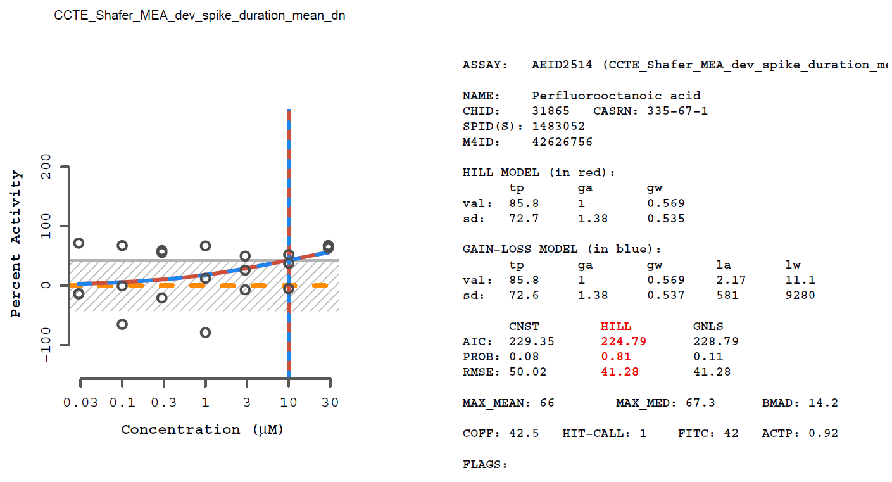
Supplemental Figure 5. Positive response for PFOA in the MEA NFA endpoint measuring decreased network spike duration

Slide 9
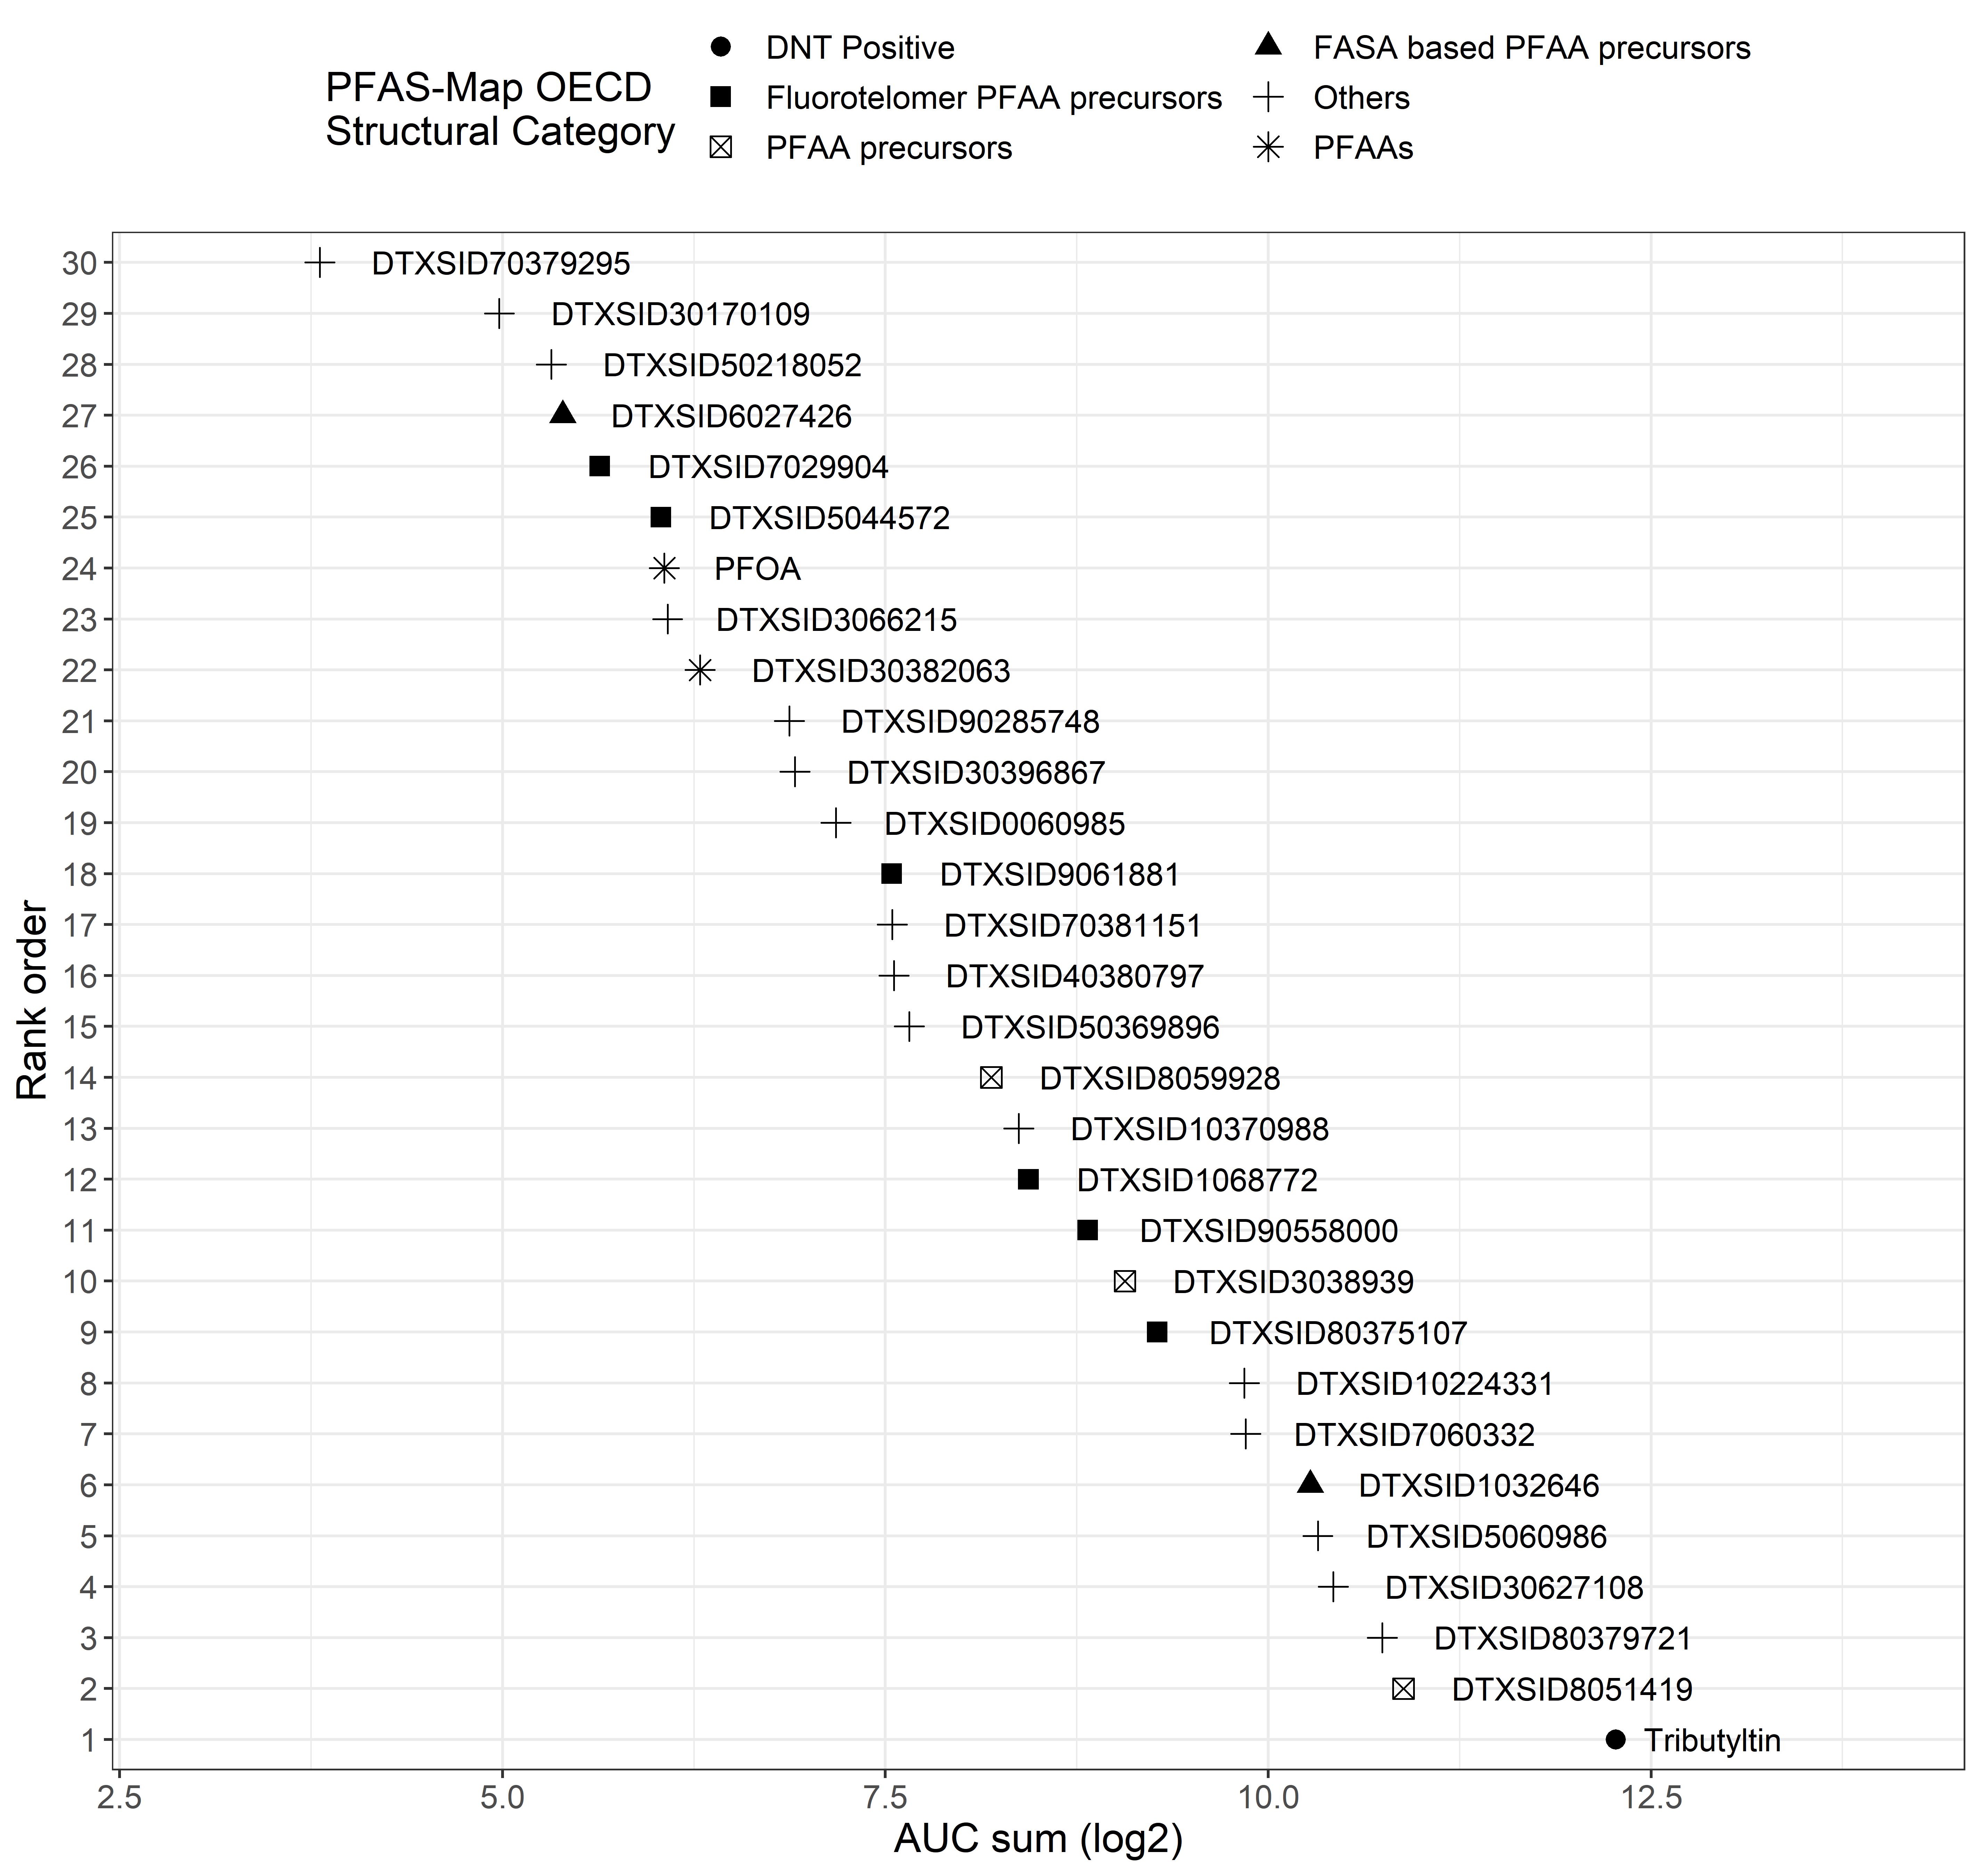
Supplemental Figure 6. Ranked AUC sum in the MEA NFA

Slide 10
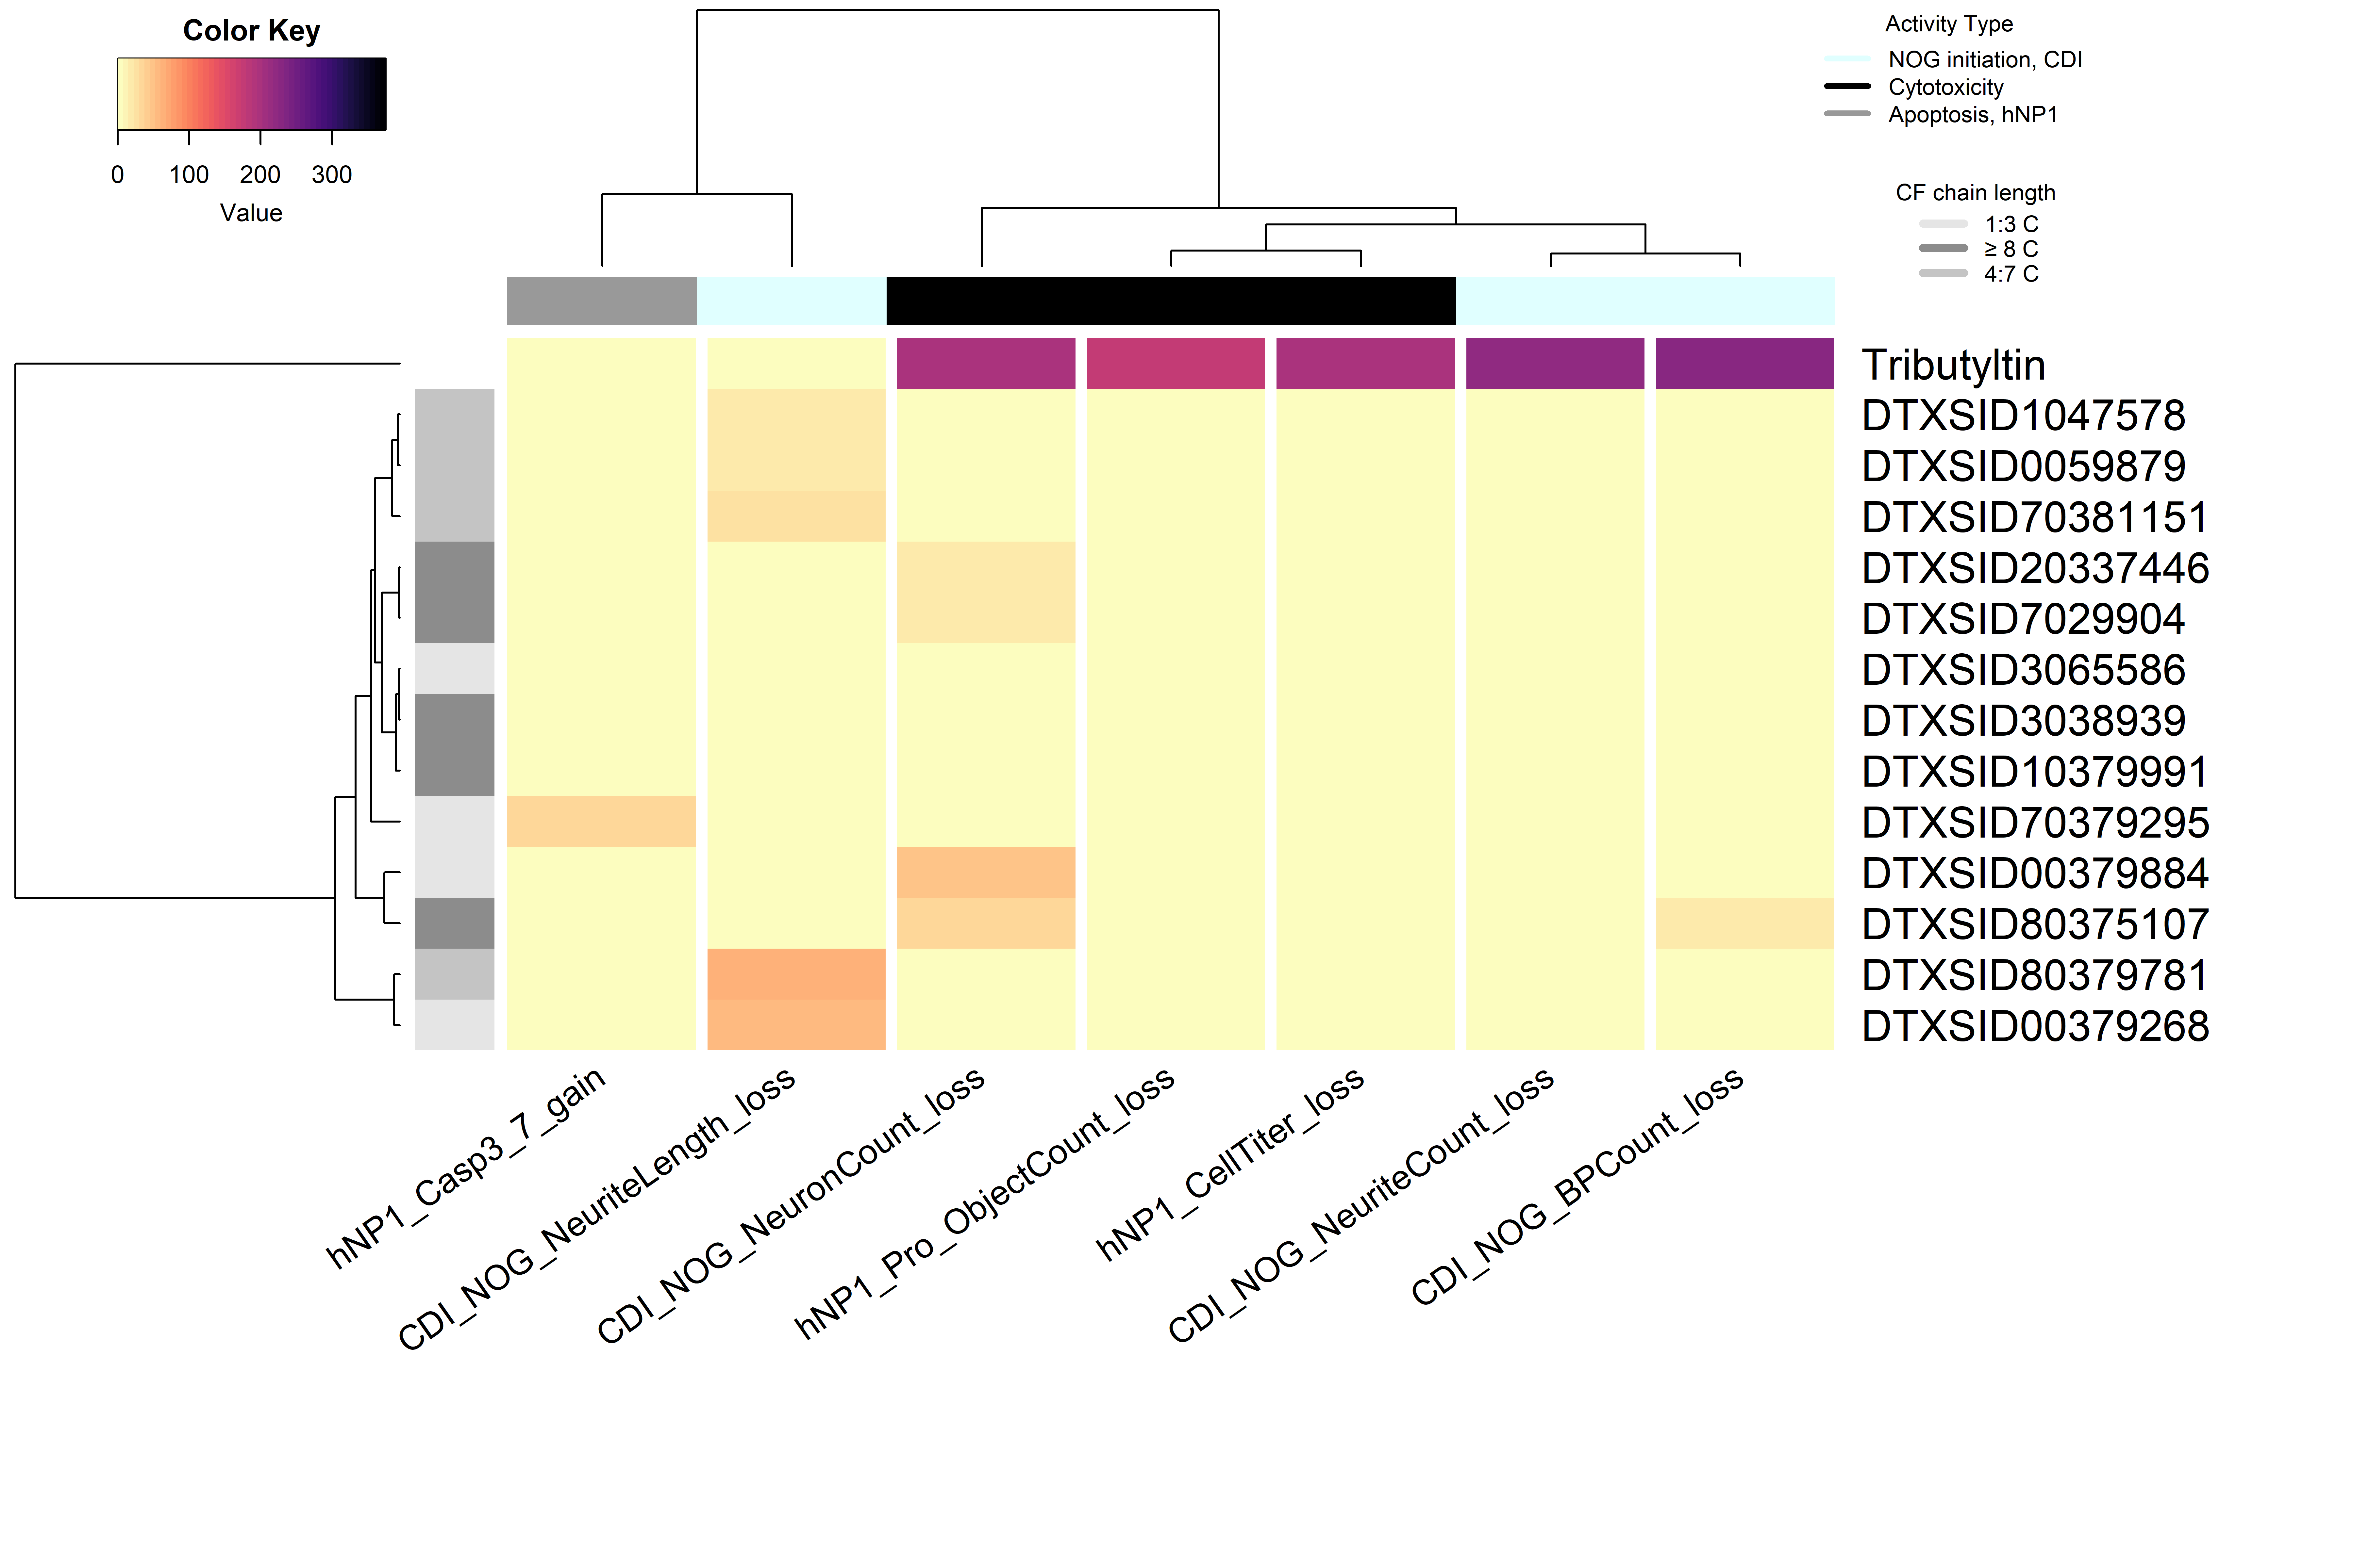
Supplemental Figure 7. AUC heatmap for PFAS screened in the HCI assays
AUC

Slide 11
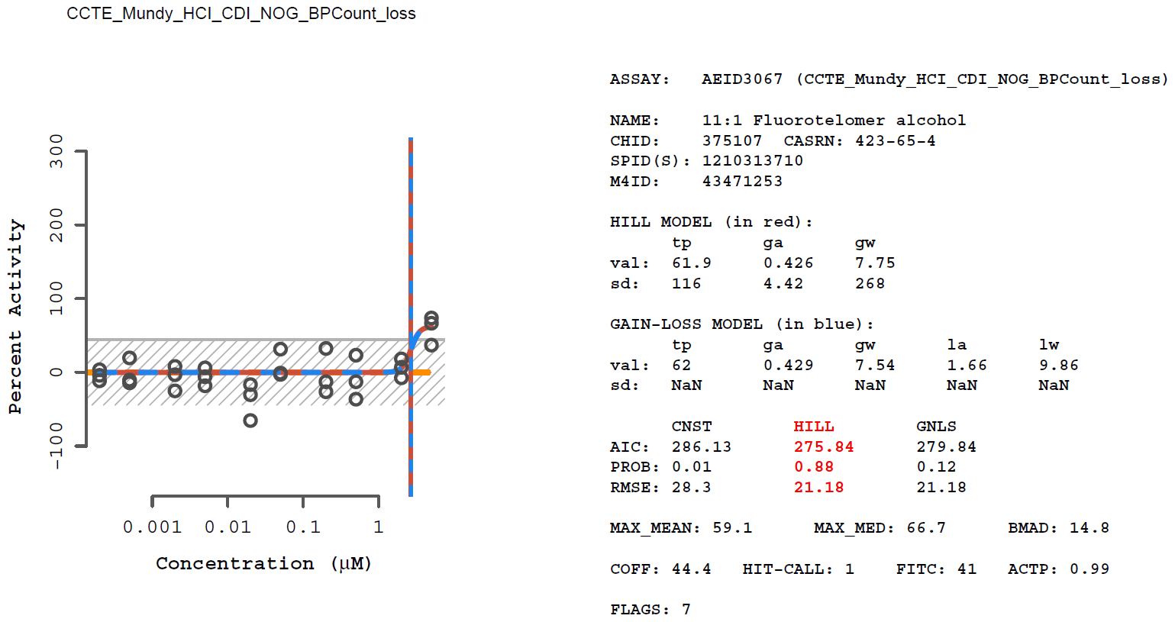
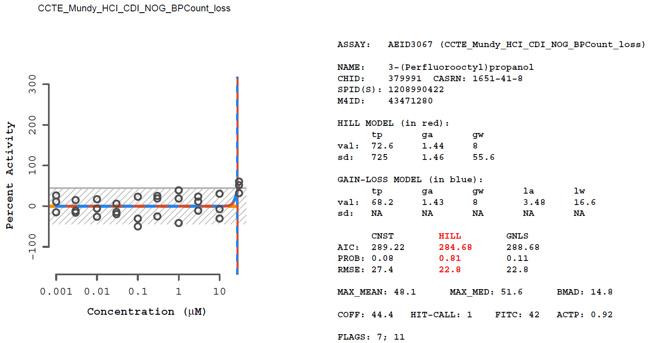
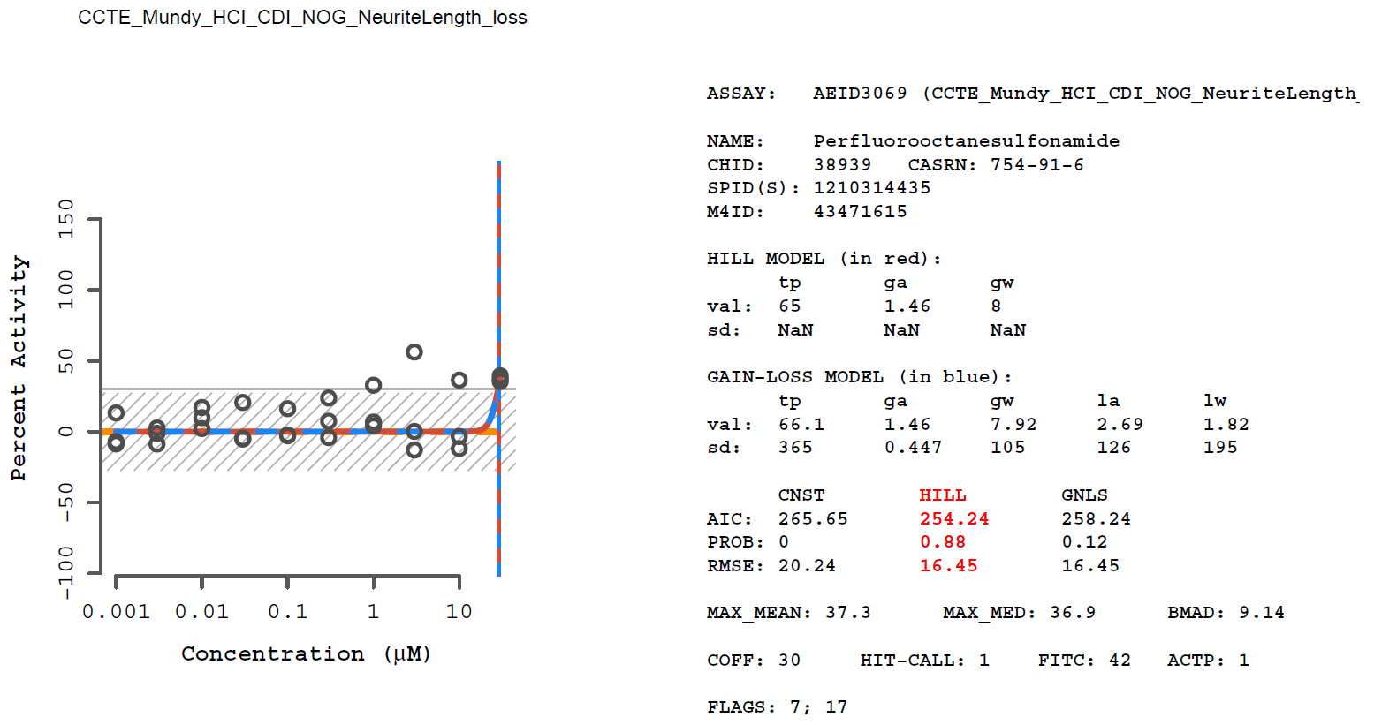
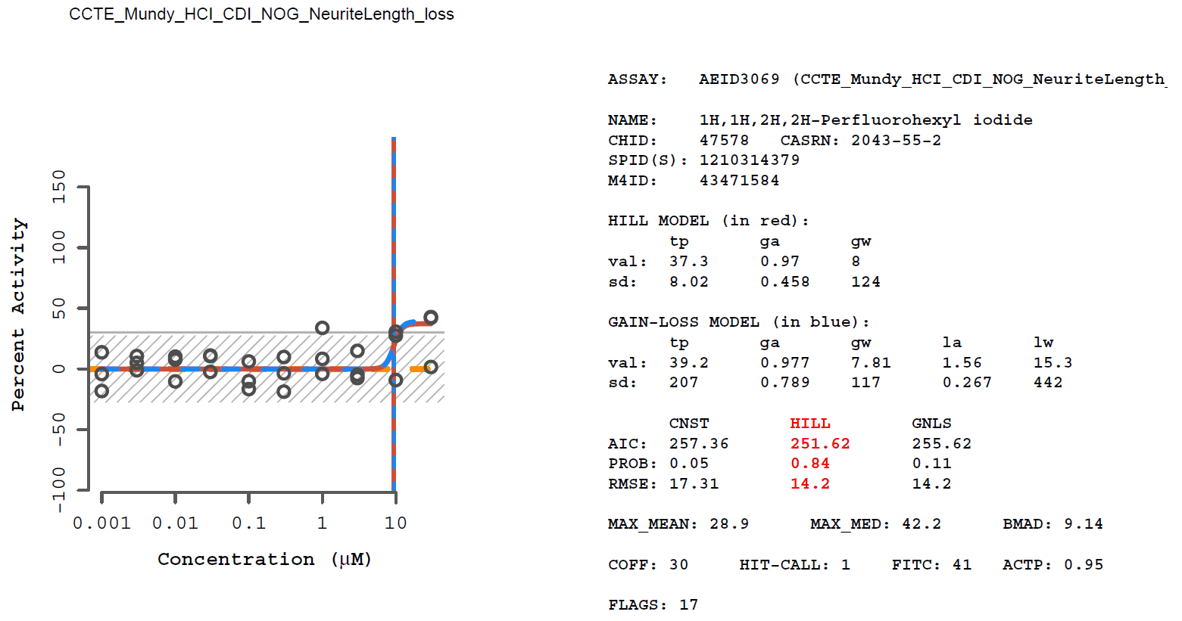
Supplemental Figure 8. Concentration response curves for PFAS active in the HCI assays

Slide 12

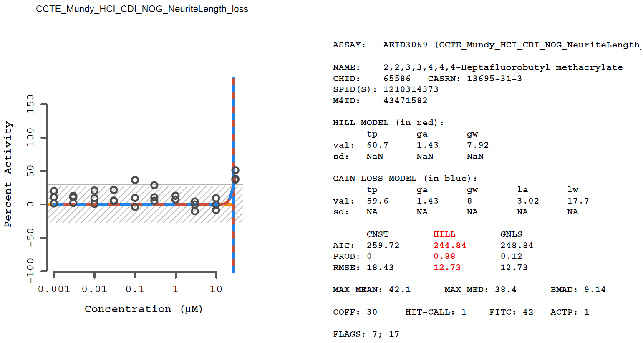
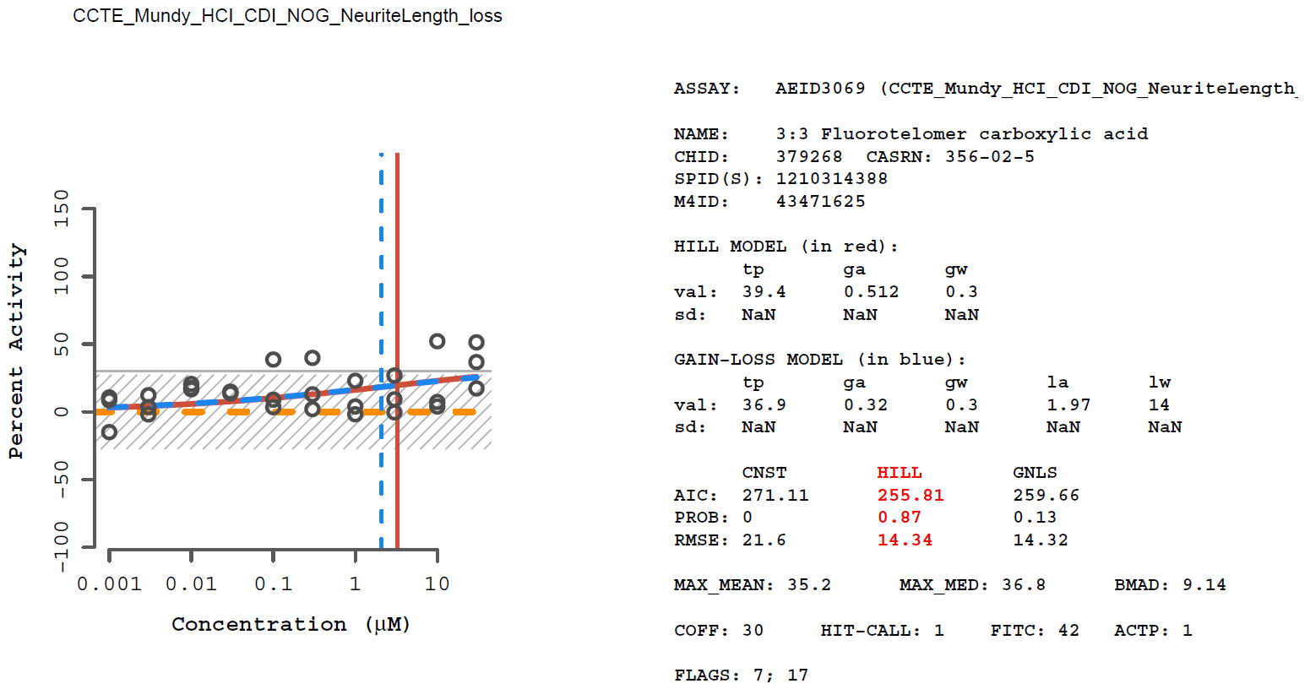
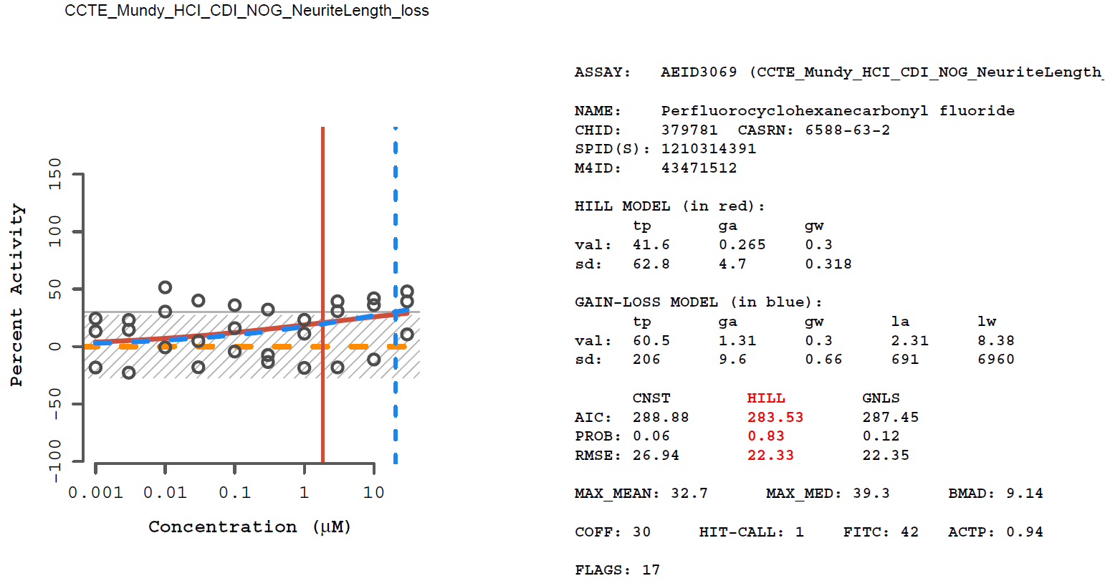
Supplemental Figure 8. Concentration response curves for PFAS active in the HCI assays

Slide 13
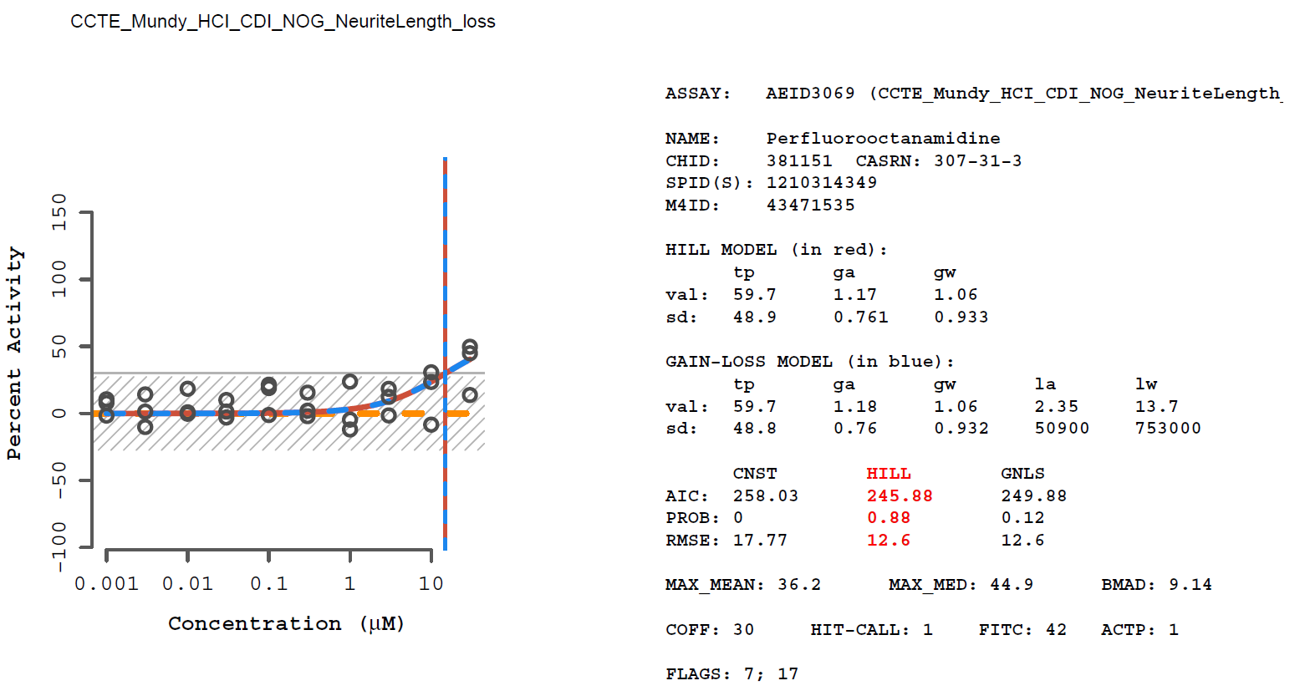
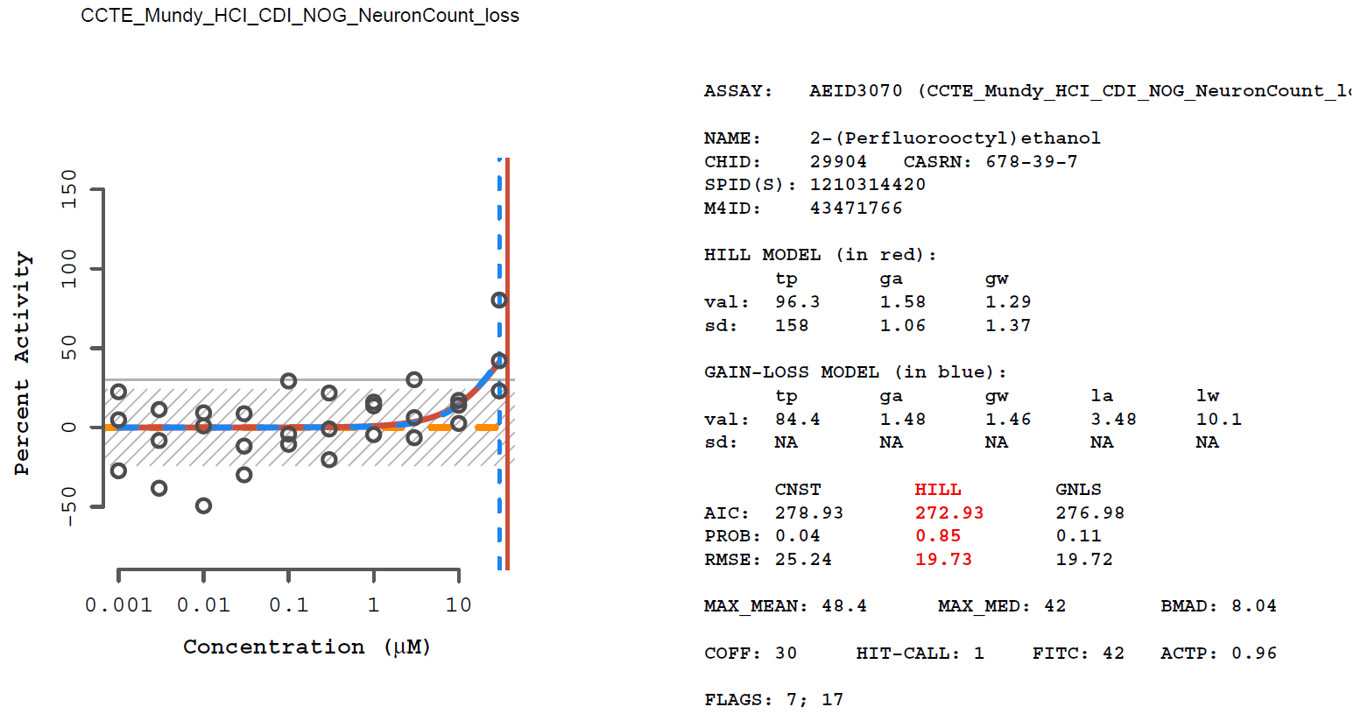
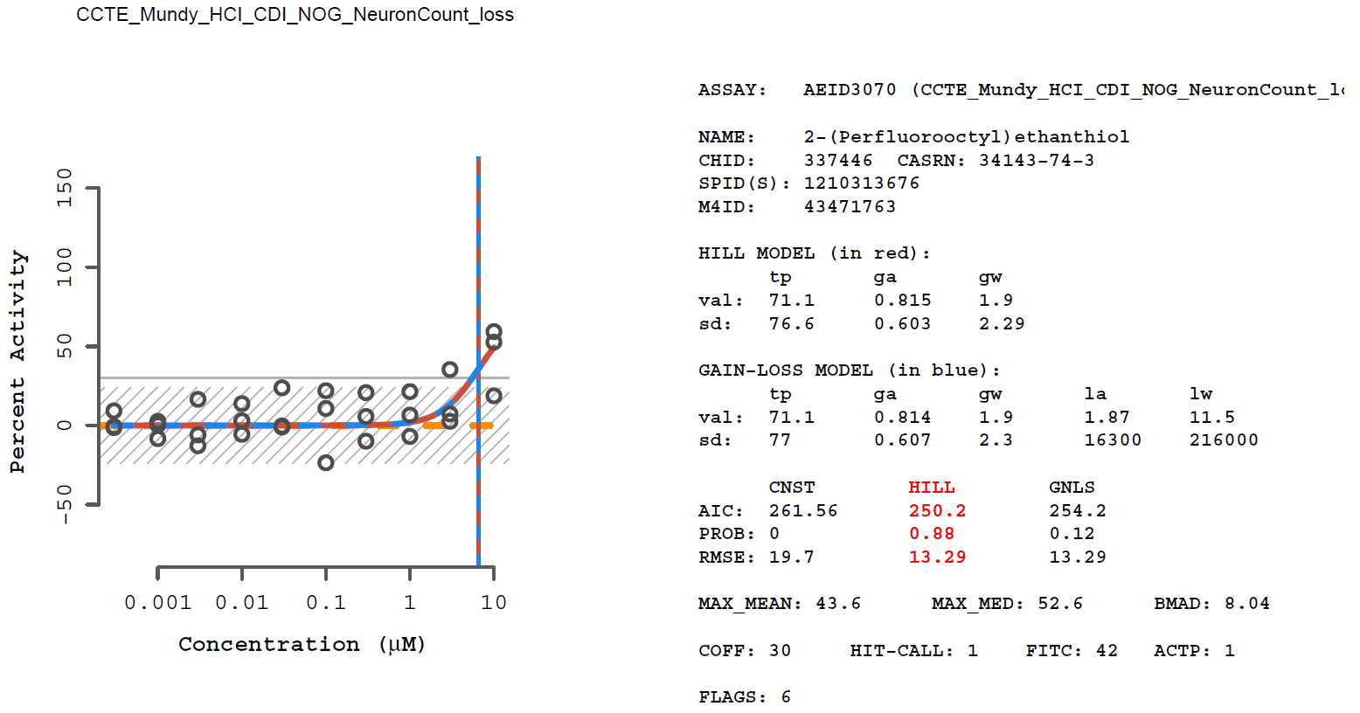
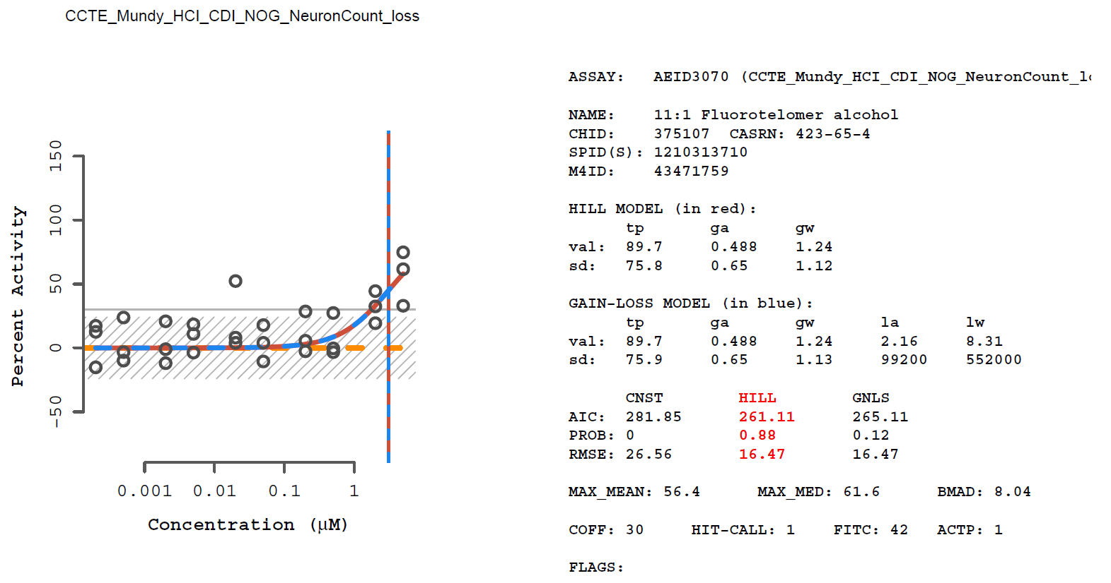
Supplemental Figure 8. Concentration response curves for PFAS active in the HCI assays

Slide 14
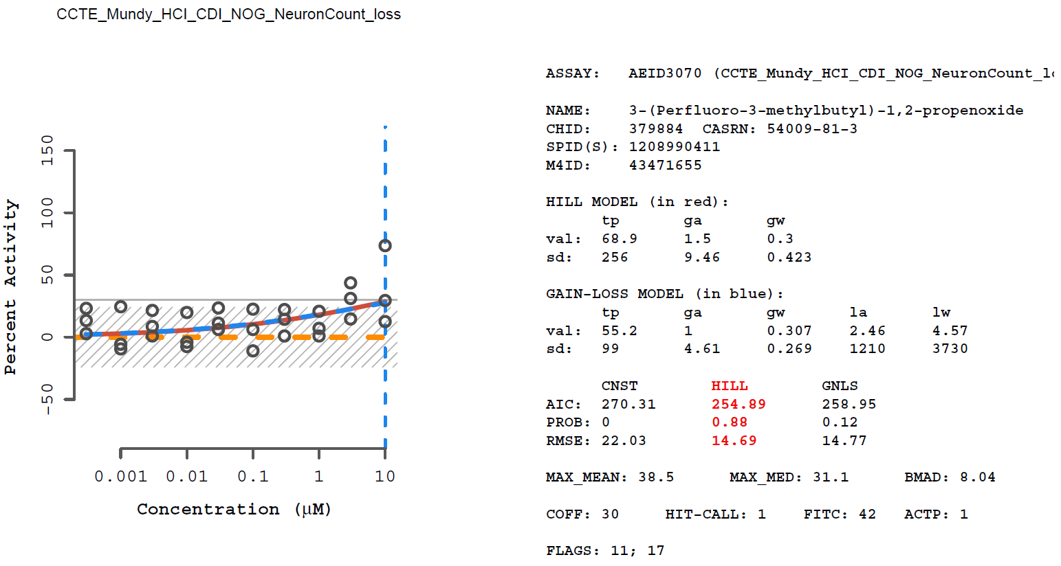
Supplemental Figure 8. Concentration response curves for PFAS active in the HCI assays

Slide 15
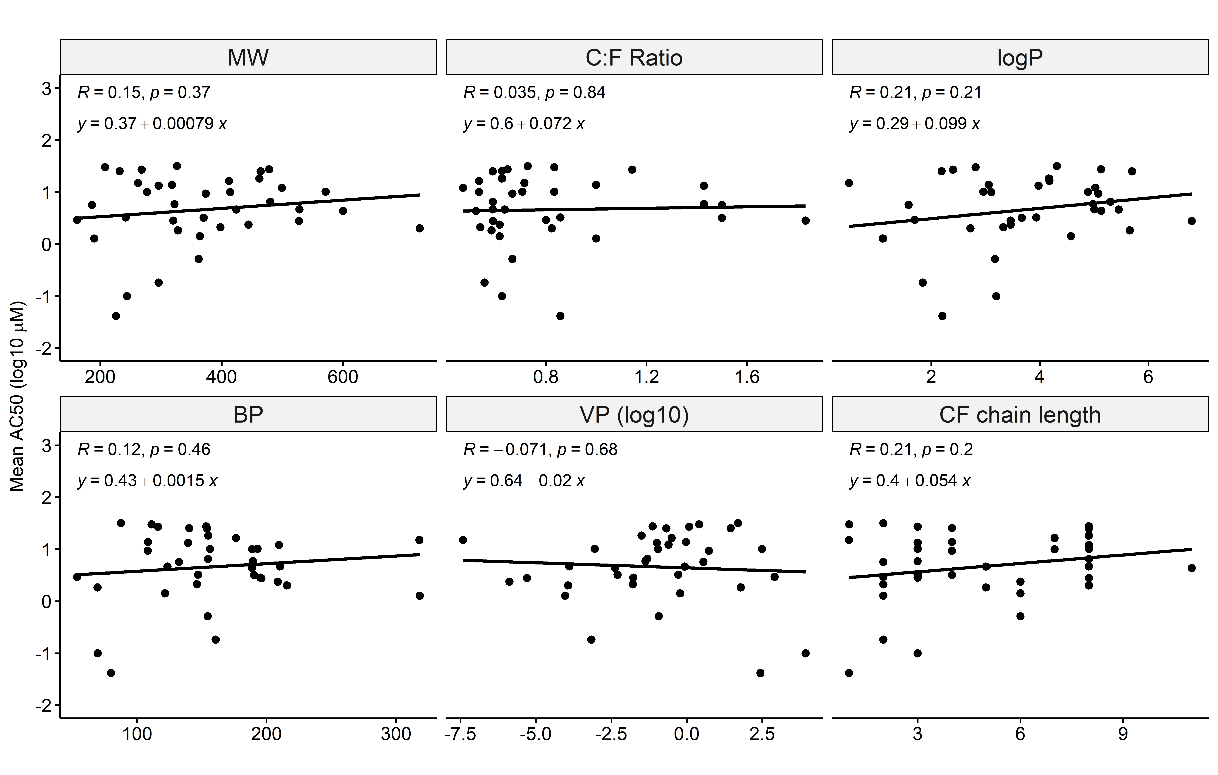
Supplemental Figure 9. Chemical properties and AC50 values for active PFAS in the DNT NAM mc screening

Slide 16
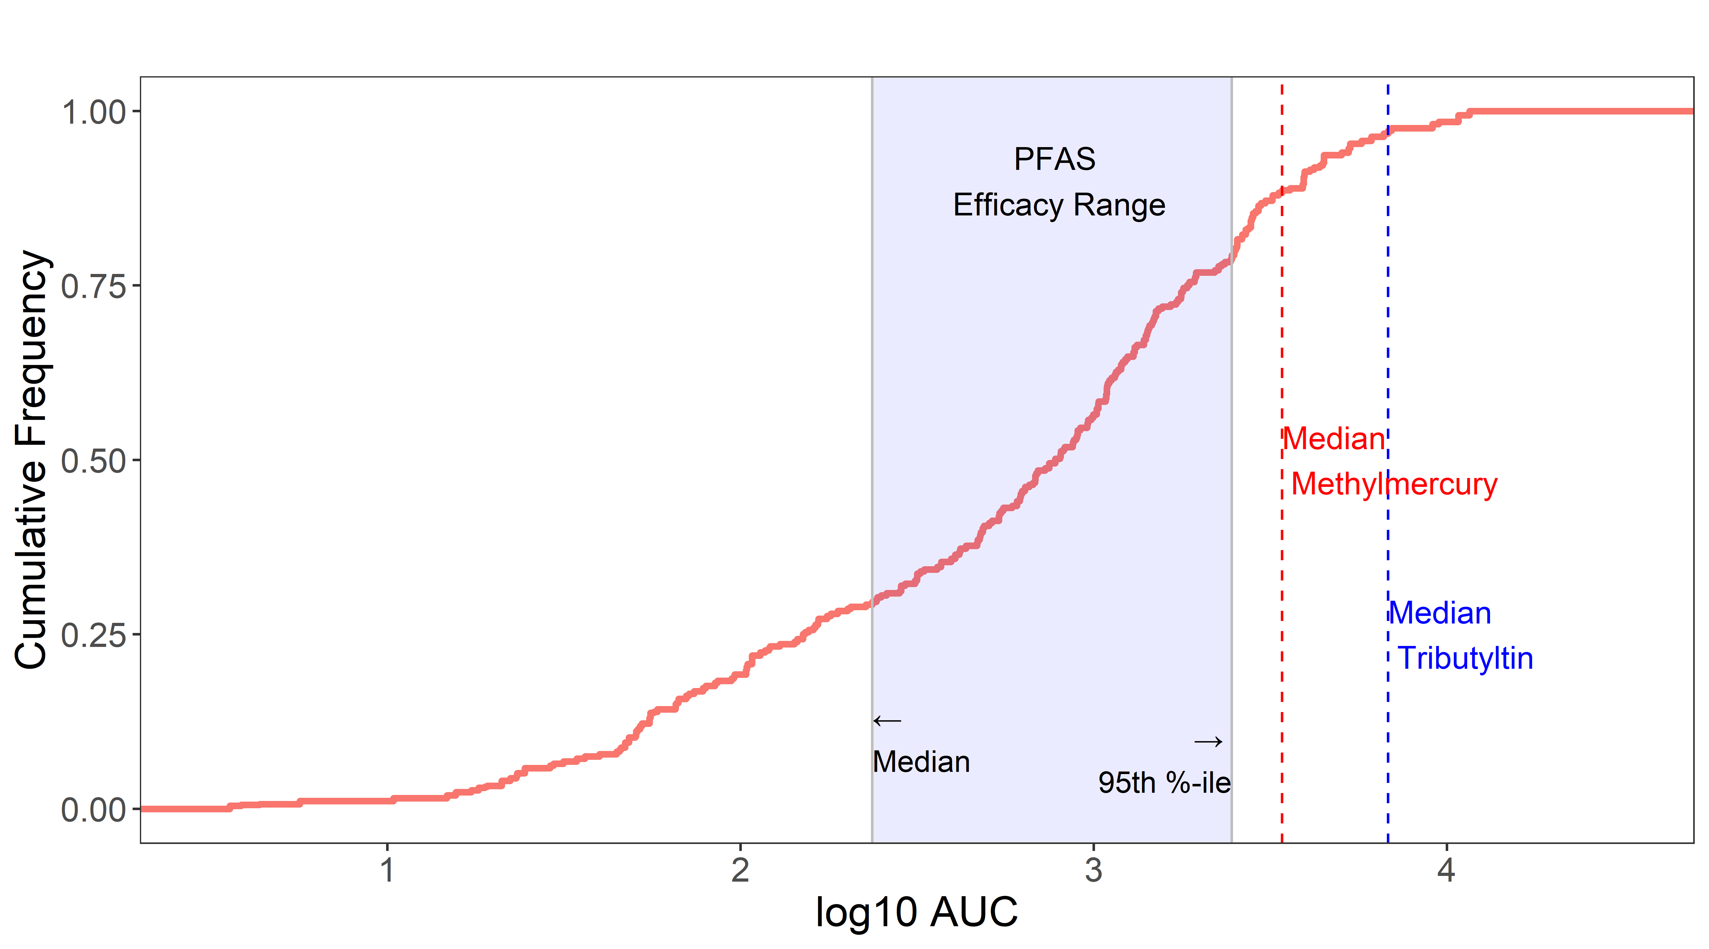
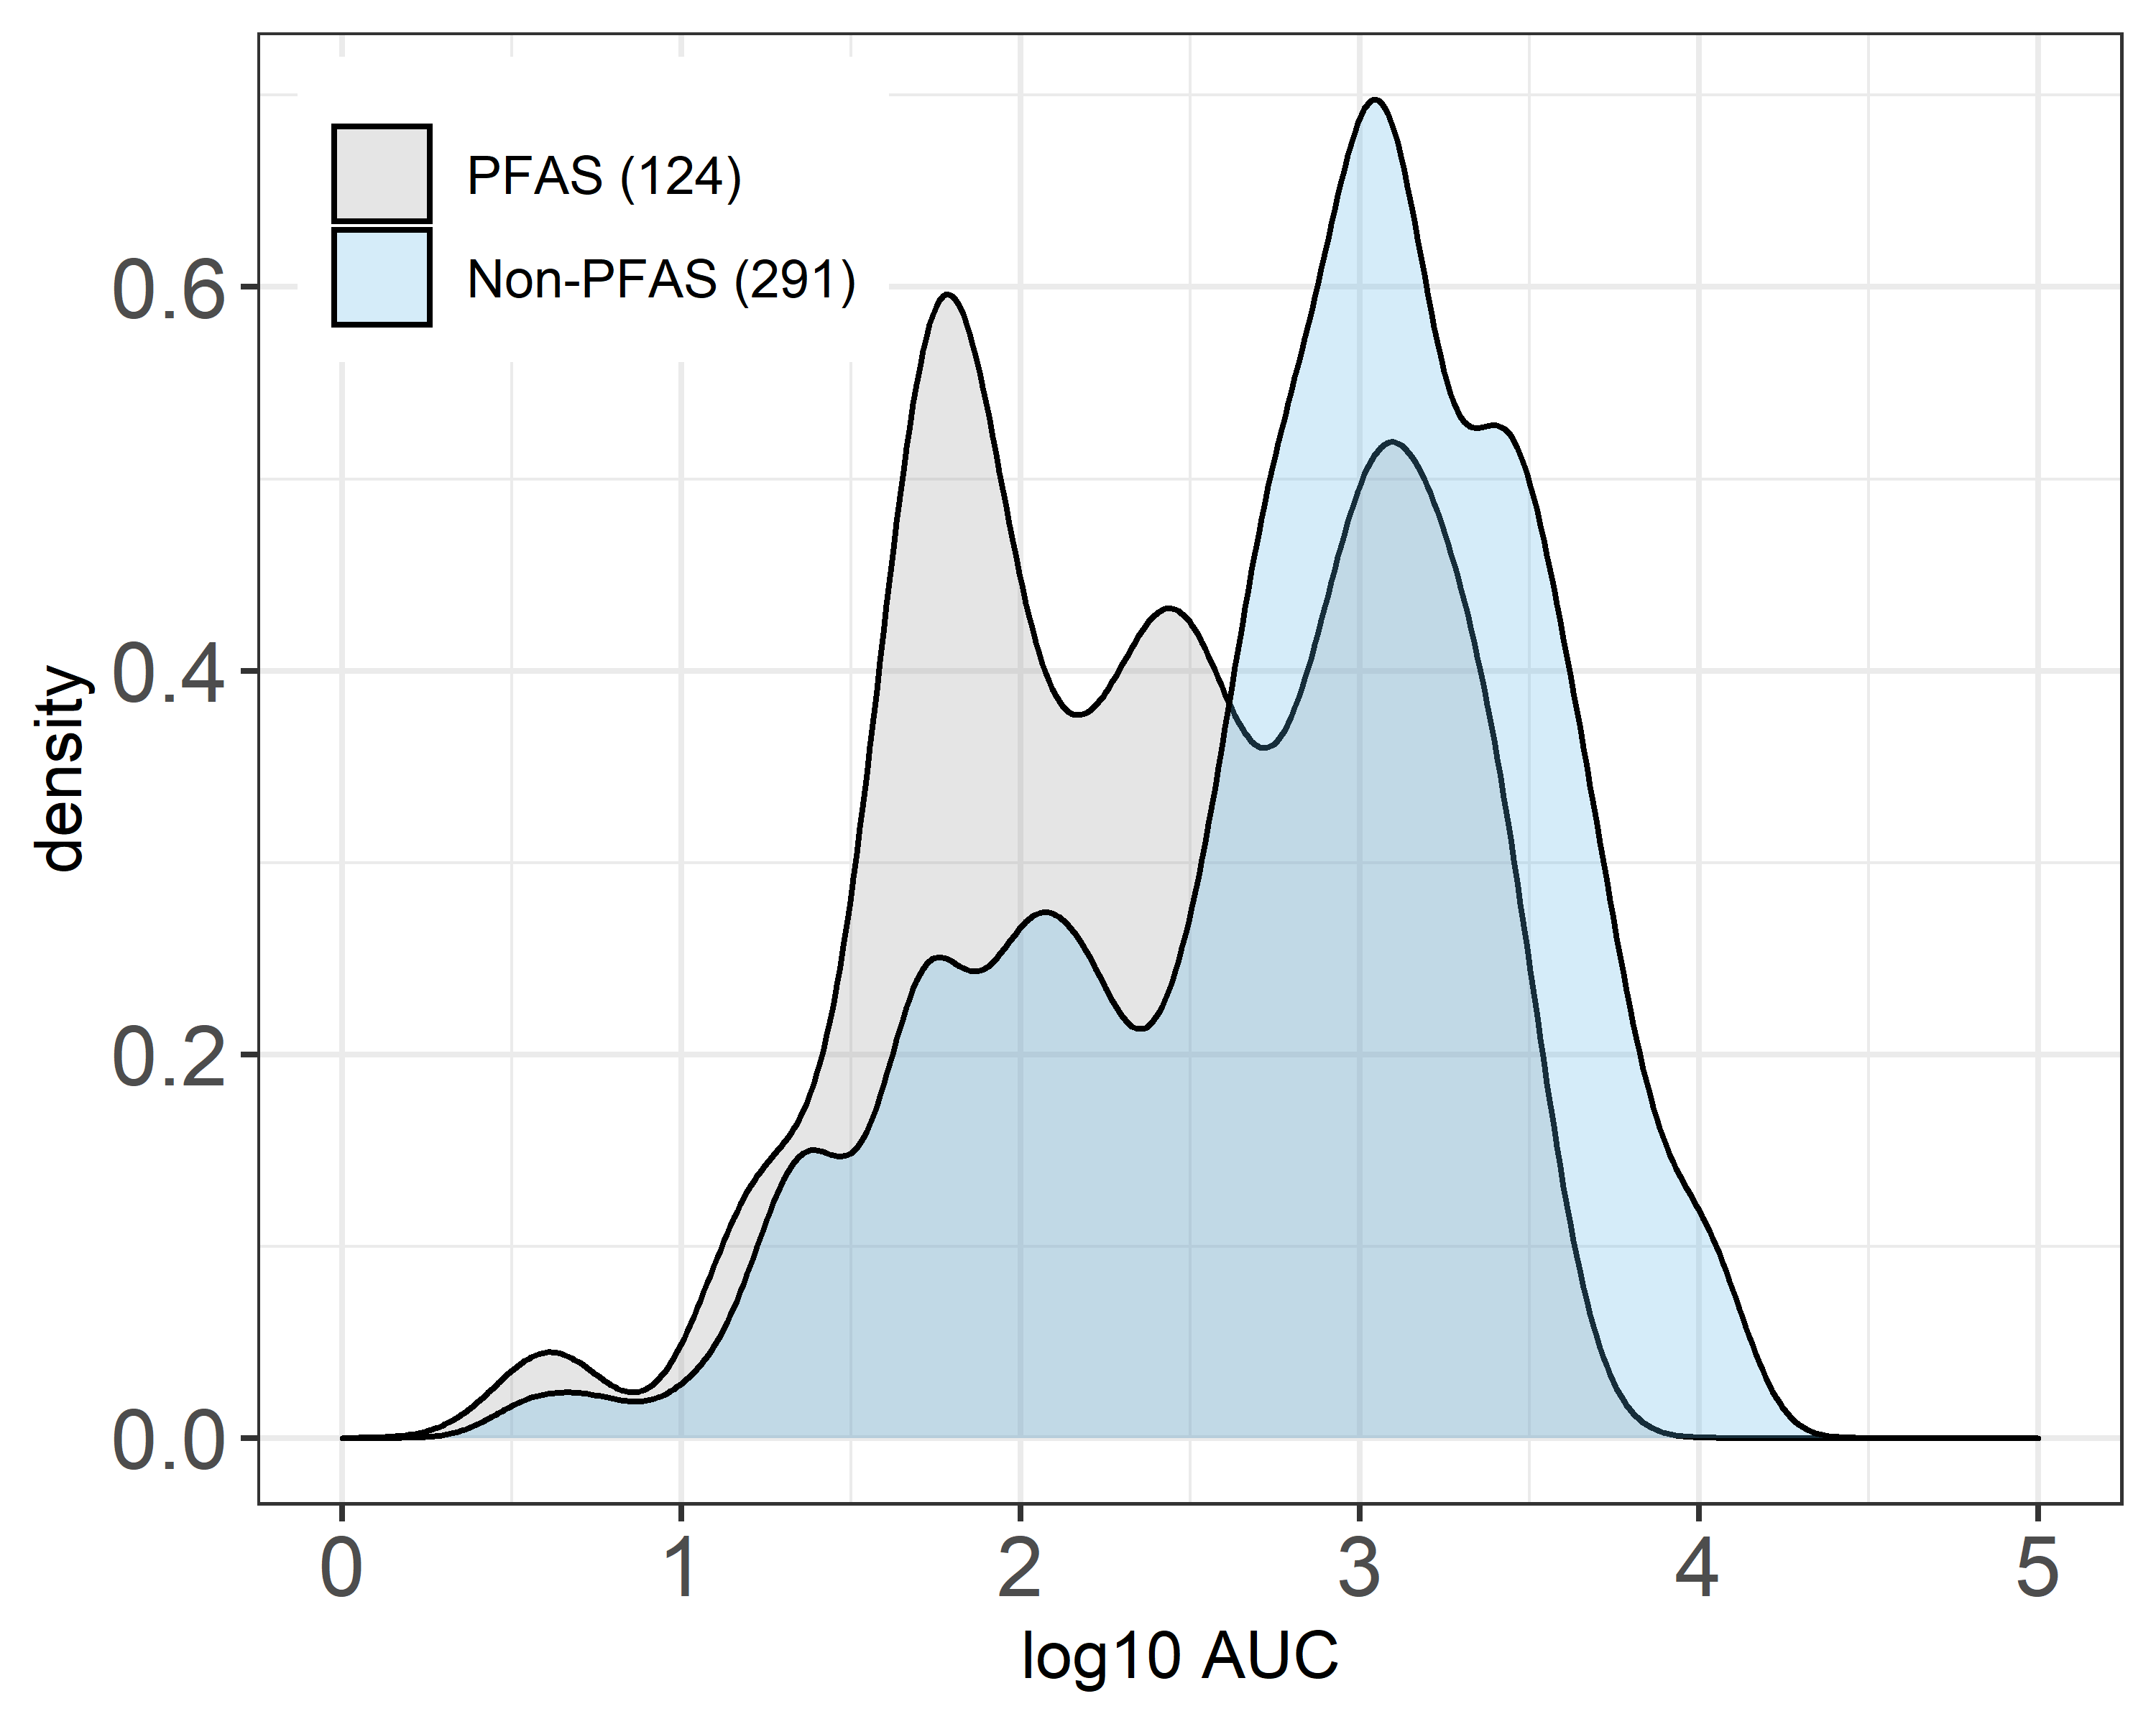
Supplemental Figure 10. Cumulative density distribution of DNT NAM potency (AUC): PFAS versus non-PFAS chemicals

Slide 17
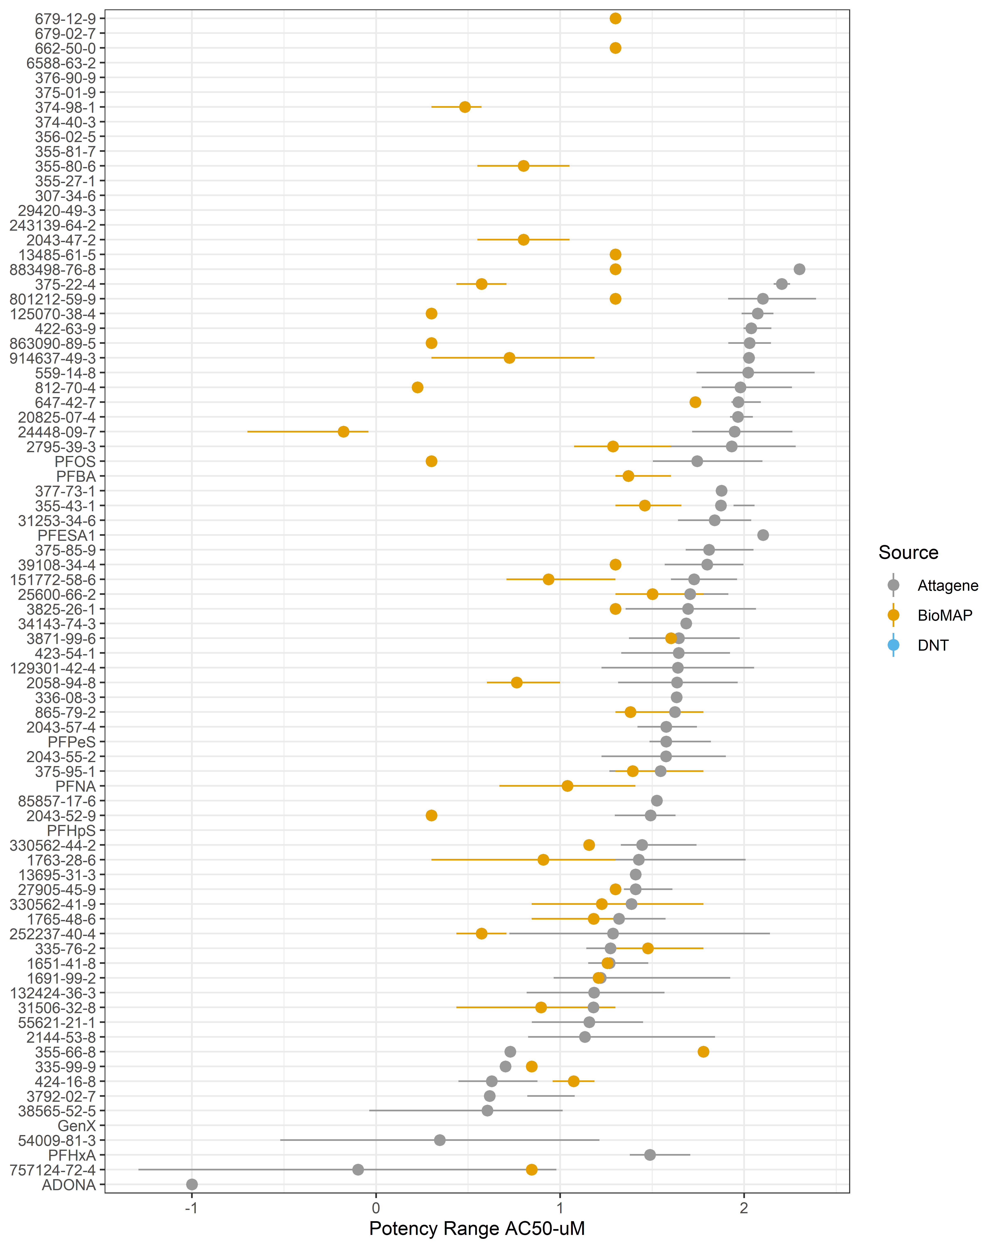
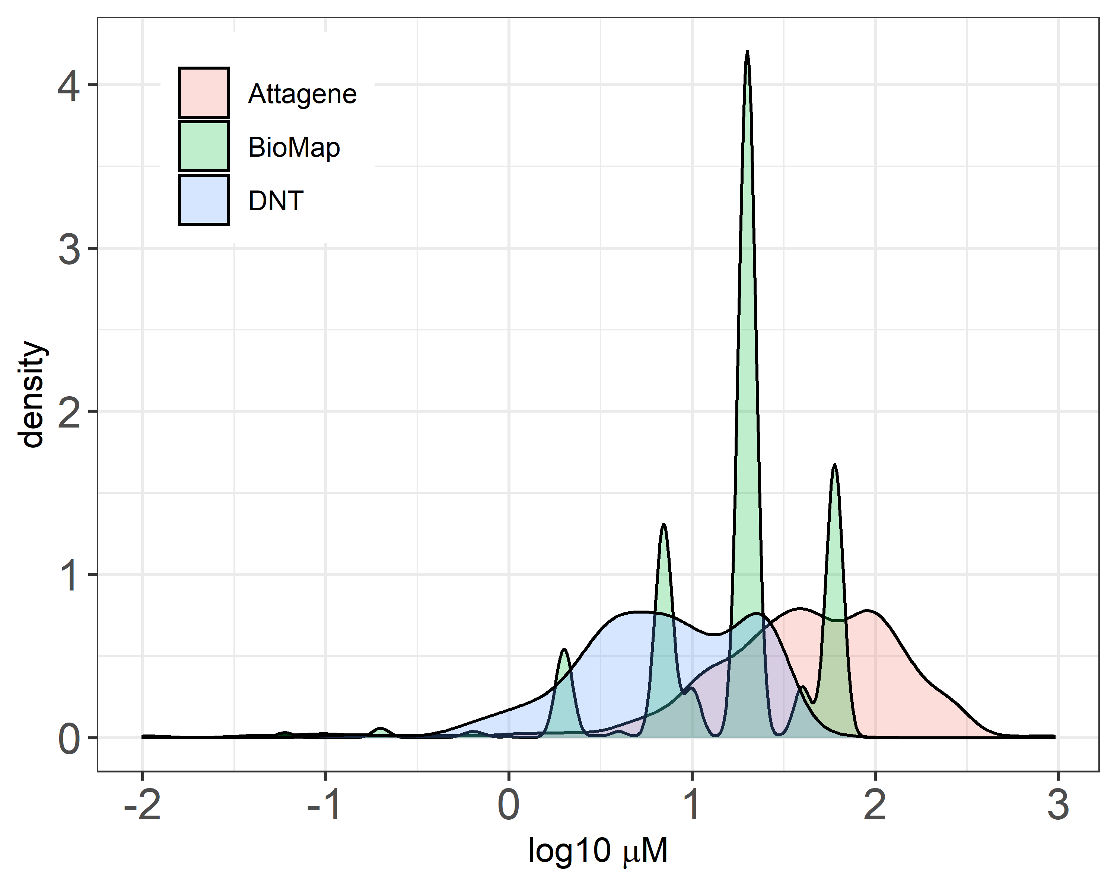
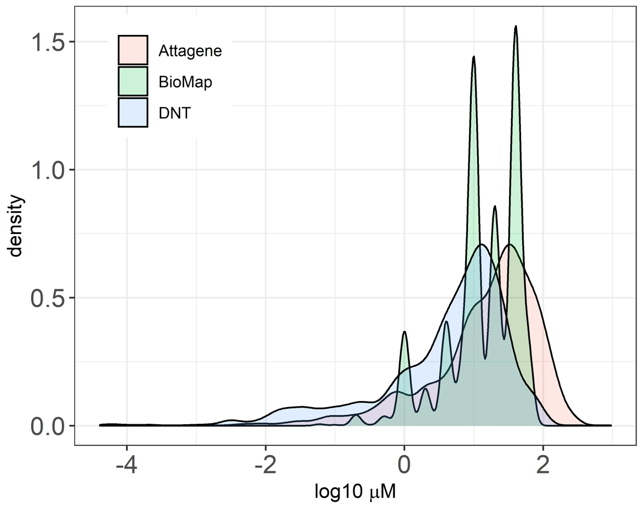
Supplemental Figure 11
A) BioMAP and Attagene bioactivity for PFAS that were inactive in the DNT NAMs
B) Density plot comparing PFAS potencies in the BioMAP, Attagene and DNT NAMs
C) Density plot potencies for all available chemicals tested across the three assay suites

